Slide 1
A Steatite Vessel Rim Sherd from 41SS178, San Saba Texas: Consideration of Possible Late Prehistoric Connections between the Northwestern and Southern Plains
By
Christopher Lintz
Texas Parks and Wildlife Department
Dan Prikryl
Lower Colorado River Authority
February 2015

Slide 2
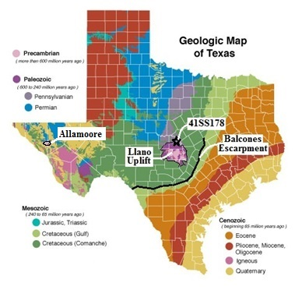
The Lower Colorado River Authority archeologists conducted work at a prehistoric site at the edge of San Saba community, within the Colorado River drainage basin.
San Saba County is near NE margin of Llano Uplift, a Precambrian-early Paleozoic region of Central Texas.

Slide 3
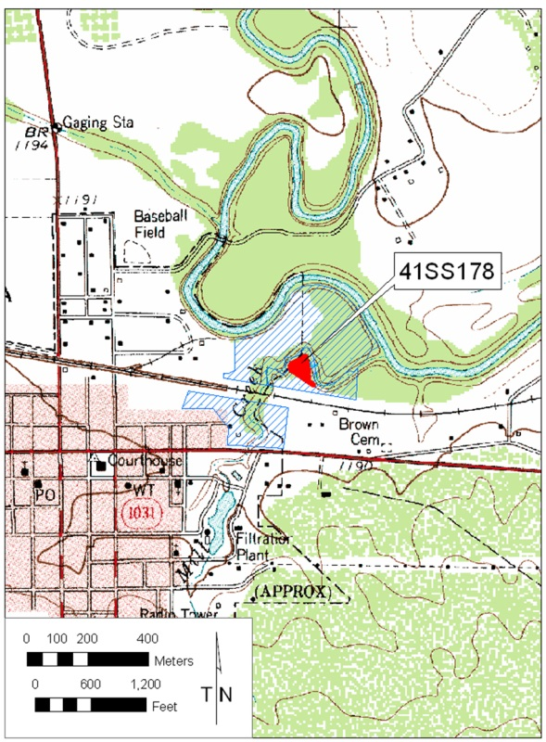
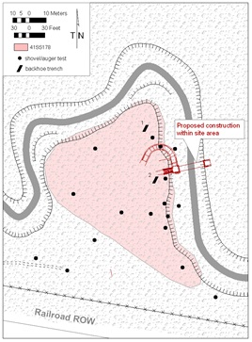
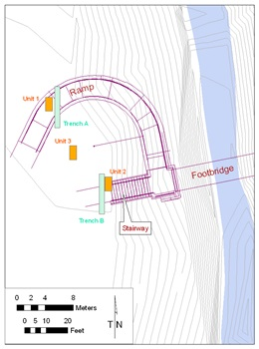
The 2010 excavations assessed proposed foot bridge foundation impacts in a city park. The work identified multicomponent campsite 41SS178 and recovered a ground stone bowl rim sherd.
Site 41SS178 is along Mill Creek northeast of the town of
San Saba.
17 Shovel tests and 2 backhoe trenches defined site limits.
Two Trenches and three 1 x 2 m test pits used to mitigate adverse project effects.

Slide 4
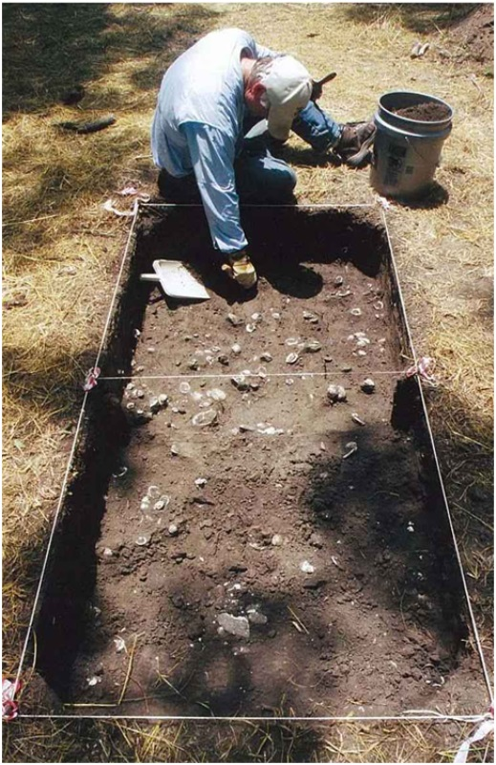
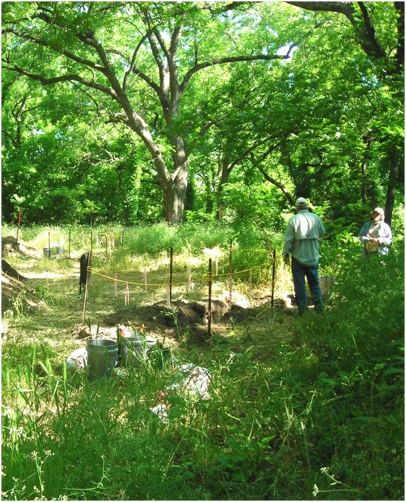
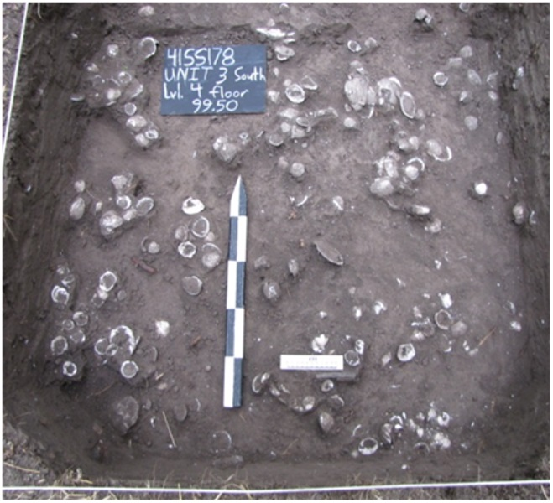
Austin phase component characterized by mussel shell discard features from nomadic hunter-gatherer groups.
One of three 1 x 2 m hand-dug test pits
Occupation on level terrace tread next to deeply incised creek channel.
Dense fresh water mussel shell discard feature lower component at 41SS178.
Only one metal can lid and one flower pot fragment are from historic period.

Slide 5
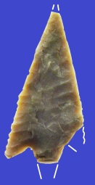
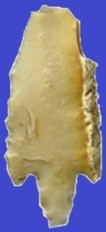
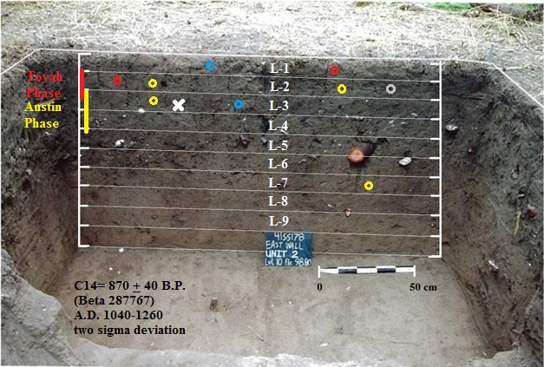
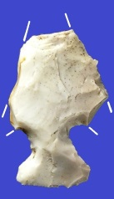
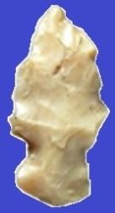
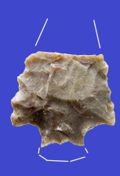
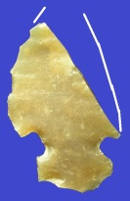
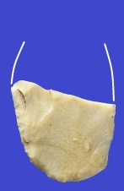
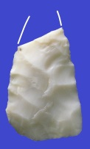
Idealized Stratigraphy and Depth of Diagnostic Artifacts
Perdiz
Unit 2N, L1
Perdiz
Unit 2N, L2
Stone Bowl
Unit 2S, L2
Scallorn
Unit 3N, L2
Scallorn
Unit 1N, L2
Probable Scallorn
Unit 2N, L3
Scallorn
Unit 3N, L-7
Rodent Hole
Initial Late Prehistoric II
Austin Phase/Interval
Ca. AD 1000 – 1300 (Scallorn Points)
Terminal Late Prehistoric II Toyah Phase/Interval
Ca. A.D. 1300 – 1700
(Perdiz Points)
Unit 2N, L1
Unit 2S, L-3
Arrow Preform Fragments

Slide 6
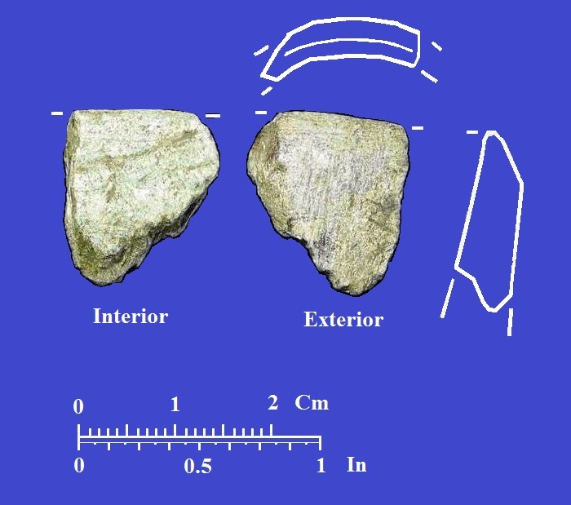
Steatite bowl fragment from 41SS178
A single rim fragment of a steatite vessel was recovered from screened fill from Level 2.
The rim measures only 1.80 x 1.62 cm with a slightly contracting wall measuring 0.51 cm thick at the fragmentary lower rim.
The exterior lip is beveled.
Orifice curvature suggests a vessel diameter of about 20 cm.
The rim fragment lip angle suggests a deep bowl vessel form.

Slide 7
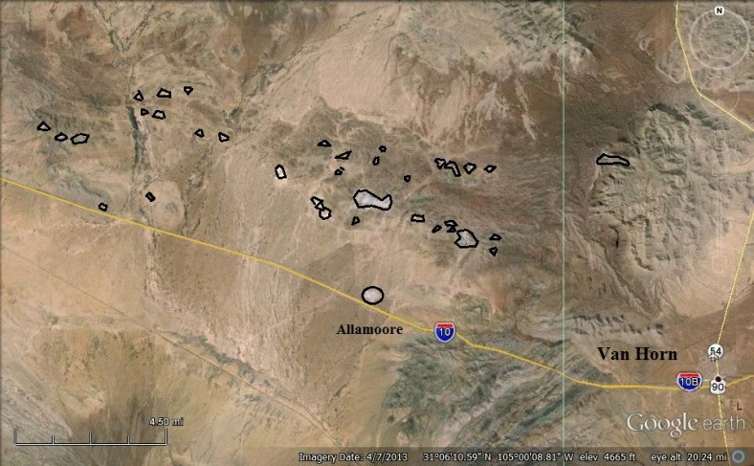
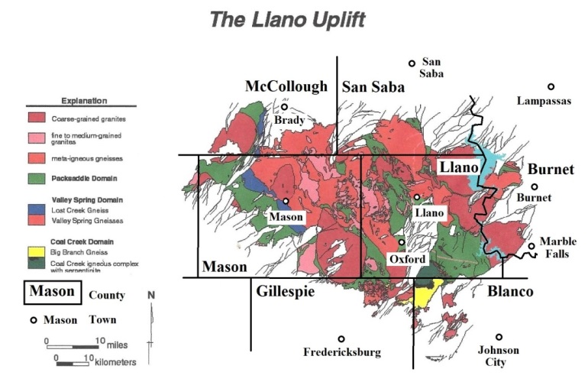
Steatite Outcrops and Quarries in Texas
Steatite/Soapstone is a metamorphic alteration of talc.
Occurs in two districts within Texas.
Modern steatite quarries operate at Allamoore, Texas, South end of Sierra Diablo Mountains
Early historic steatite and serpentine quarries along Coal Creek near Oxford within Llano Uplift
Coal Creek
Allamoore talc mines identified from Google Earth

Slide 8
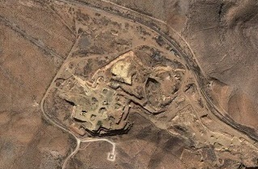
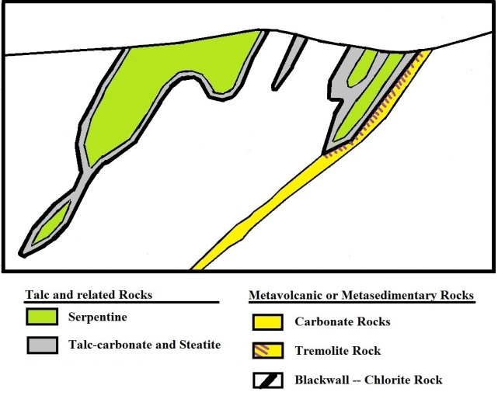
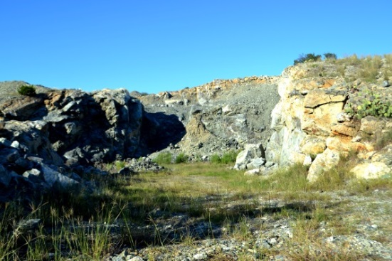
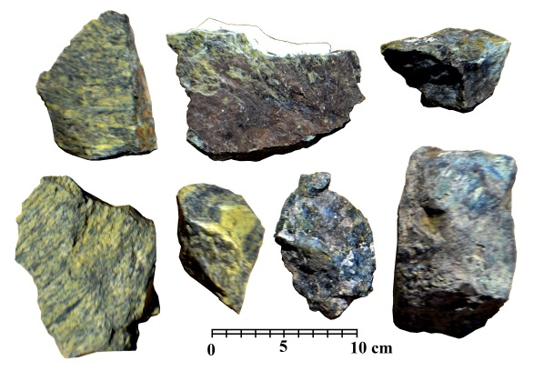
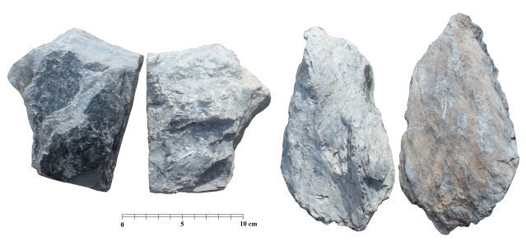
Talc, Steatite and Serpentine Formation Processes
Steatite is mostly talc, a hydrated magnesium silicate formed by two ways:
1) Chemical alteration by metamorphic heating of ultramafic rocks rich in iron or magnesium but low in silica.
2) Chemical alteration and replacement of carbonate-rich sedimentary rocks by silica and minerals by
exposure to hydrogeothermal conditions (hot spring water).
Allamoore talc quarry 13.5 km west of Van Horn, Hudspeth County.
Main quarry at Coal Creek/Willow City, Llano Uplift, Gillespie County.
Spatial relationship of steatite, talc and serpentine during formation. (after Greene 1995 “Talc Resources of the Coterminous United States” [preliminary manuscript] U.S. Geological Survey, Open File Report 95-586, Menlo Park)
Steatite samples from
Allamoore Formation,
Hudspeth County.
Serpentine samples from
Willow City Quarry, Llano Uplift,
Gillespie County.

Slide 9
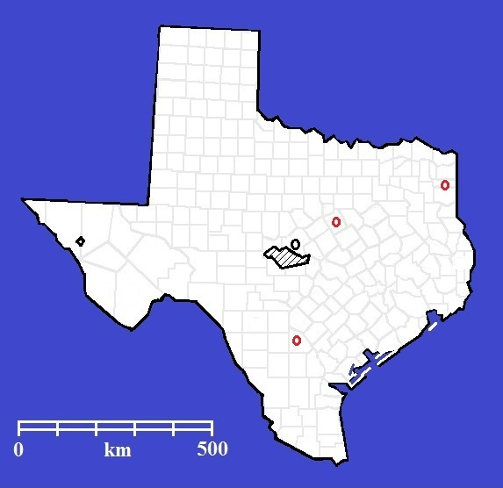
Recovered steatite artifacts in Texas
Word search of electronic Texsite atlas database identified the distribution of few steatite or soapstone artifacts in recorded historic and prehistoric Texas archaeological sites.
Historic
Artifacts
Prehistoric steatite artifacts occur as elbow and cloud blower pipes, pendants, worked stone, and “abrader”
Seam Marker
Prehistoric
Artifacts
Allamoore Outcrop
41SS178
Urn
sherd
Llano Uplift Outcrop
Elbow
Pipes
Unmodified
stone
“Pencil”
41SS178
Allamoore
Outcrop
Llano Uplift
Outcrop
Worked stone
Pendants
Cloud -blower Tubular Pipes
Historic steatite artifacts occur on 19th-20th century historic sites as pencils, seam markers,
or sherds from urn.
“Abrader”

Slide 10
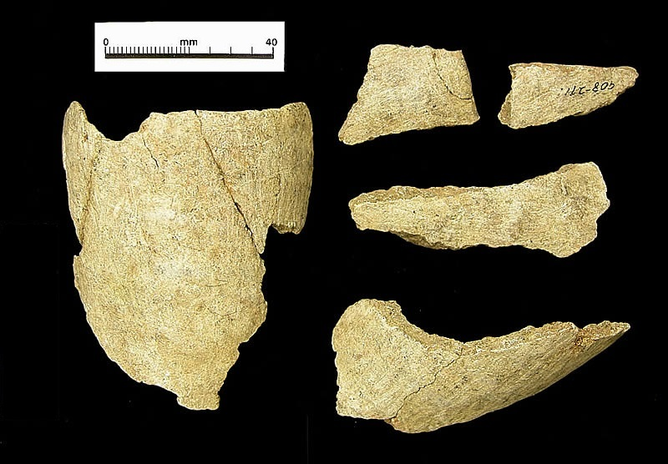
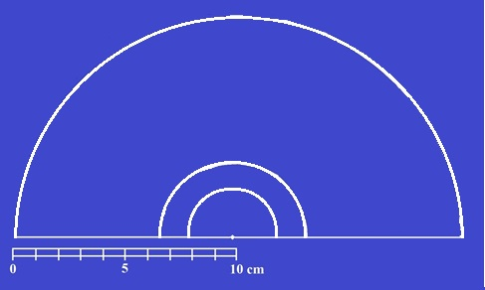
Prehistoric steatite rim sherd artifacts from Texas
41SS178 Bowl
Cloud Blower pipes
Kincaid Pipe
Live Oak Co. Pipe
www.texasbeyond history.net/kincaid/past.
Tubular or cloud-blower pipes:
Kincaid Shelter, Uvalde County: max. orifice diameter 6.4 cm.
2) Site 41LK67, Live Oak County:
Comparison of projected orifice diameters of cloud-blower pipes from 41LK67 and Kincaid shelter vs. rim sherd bowl fragment from 41SS178.
Projected curvature of San Saba vessel greatly exceeds diameters of tubular pipes.
max. orifice diameter 2.5 to 3 cm.

Slide 11
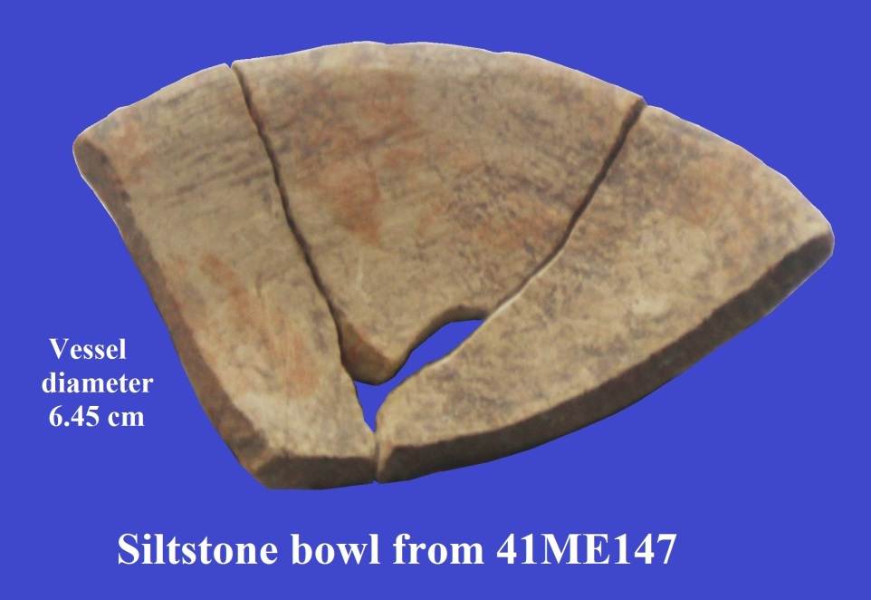
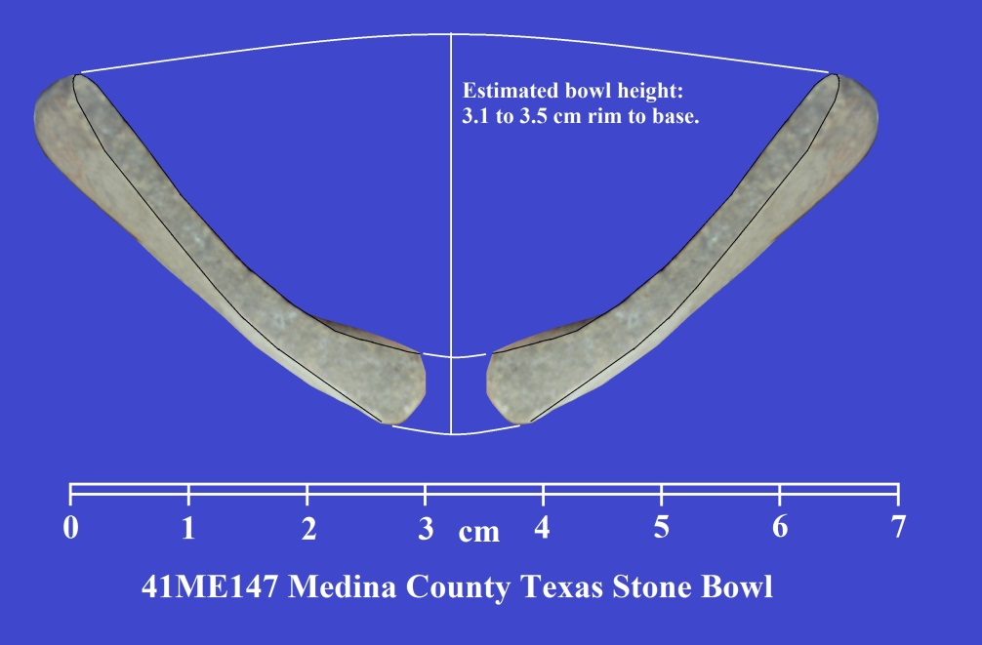
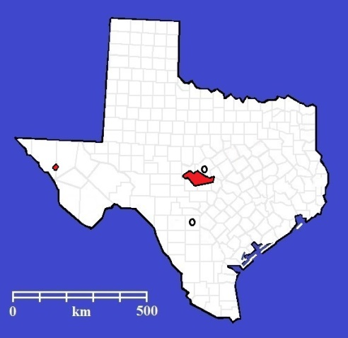
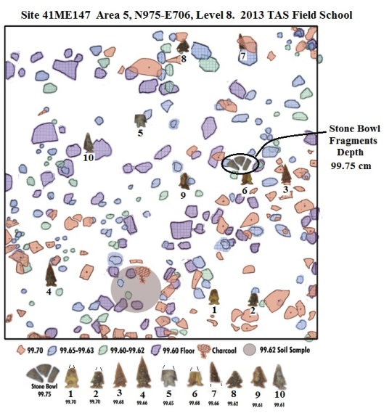
Prehistoric Stone Bowl Examples are rare in Texas.
A fragmentary shallow basin siltstone bowl found during TAS dig
from Late Archaic contexts at 41ME147, in Medina County.
Steatite Outcrops
San Saba County Bowl
Prehistoric Texas cultures do not have a steatite bowl-manufacturing tradition.
Medina County Bowl
Medina site has the only other known stone vessel from prehistoric
contexts in Texas.
Bowl associations dominated by Frio Points (200 B.C .– A.D. 600)

Slide 12
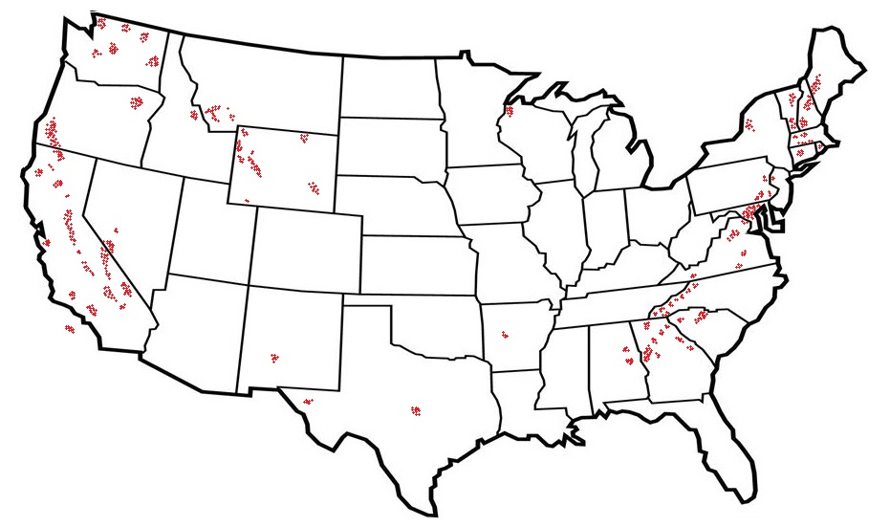
Distribution of talc-steatite-serpentine districts across the coterminus United States
Northwestern Great Plains has 14 main talc districts In Wyoming (12), Idaho (1) and Montana (1).
West Coast has 32 main talc districts In California (18), Nevada (3), Oregon (1), and Washington (10).
Data from Greene (1995) and Truncer(2004).
Other minor talc exposures are in: Superior region of Wisconsin
Ouachita Mountains of Arkansas
Llano Uplift of central Texas
Trans-Pecos of west Texas and
San Andres Mountains of New Mexico.
Appalachian Mountains have 135 main talc districts in 15 states and Washington D.C.

Slide 13
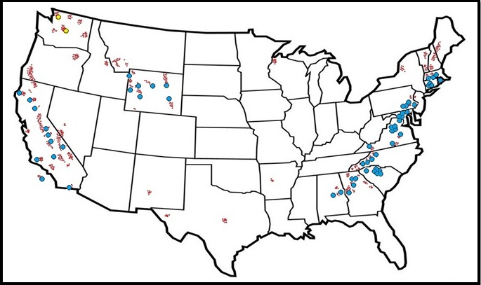
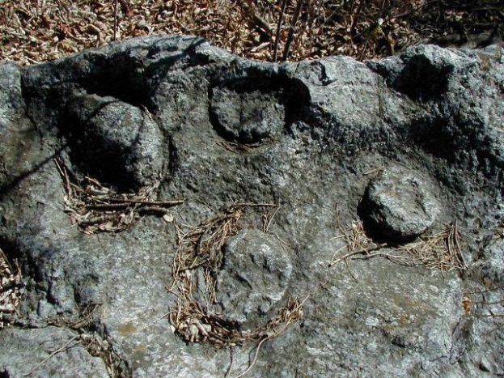
Distribution of Prehistoric Steatite Vessel Quarries in the Coterminus United States.
Northwestern Great Plains has 7 prehistoric vessel quarries– some with partially shaped preforms in situ.
Stone vessels commonly distributed across most of Wyoming, NE Utah, E Idaho, and SW Montana.
West Coast has
13 prehistoric steatite quarries in California and unknown others in Oregon and Washington.
Stone vessels commonly made in Santa Catalina Island, Stockton-Lodi and Klamath River regions.
Vessels traded across south-central California coasts, central valley and southern deserts.
Appalachian Mountains and Eastern U.S. have 50 recorded prehistoric vessel quarries.
Stone vessels commonly distributed to S. Florida, NE Louisiana, E. Tennessee & Kentucky, and all of New York.
Prehistoric vessel quarry site, Rhode Island

Slide 14
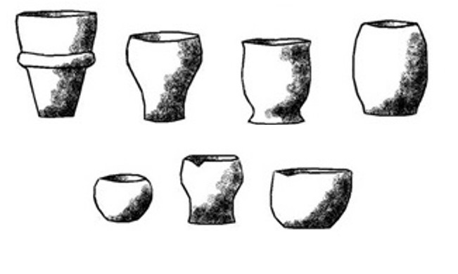
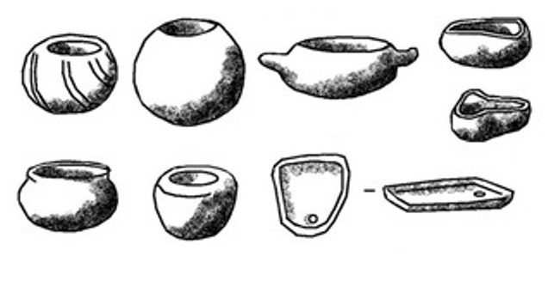
North American Steatite Vessels Forms
Appalachian Stone Vessels
Appalachian Vessels:
Crude & asymmetrical forms.
Simple bowls, Deep cubic vessels, Trays and Griddles.
Decorations rare–
Some lug handles.
Time depth: 6,300 to 2,050 B.P.
Replaced with common use of pottery
Distribution: Commonly used Alabama to Massachusetts with trade as far west as Poverty Point, NE Louisiana
Distance from Alabama quarries to central Texas , ca. 1,250 km.
NW Plains Stone Vessels
Northwest Plains Vessels:
Well-made symmetrical forms.
Constricted to open deep “flower-pot” forms bowls, and jars– mostly flat bases.
Decorations: rarely uses “fillet” around middle.
Time Depth: Rare in Late Prehistoric (less than 1,000 B.P.; most are historic period.
Distribution: Mostly mountain ranges within Wyoming.
Distance from SE Wyoming source to central Texas, ca. 1,360 km.
Southern California Stone Vessels
Southern California Vessels:
Well made, symmetrical form.
Constricted bowls, Cylindrical tall jars, Rimmed bowls and jars, Spouted bowls, Trays or Griddles.
Decorations common—
Incised fillet, lug handles.
Time Depth: 4,000/5,000 to ca. 500 B.P.; most common in Late Prehistoric Period.
Distribution: Mostly confined to Washington and Coastal/Central Valley
of California.
Distance from St. Catalina Island to central Texas, ca. 1,850 km .
The 41SS178 vessel is morphologically and temporally most closely resembles vessels from
the NW Plains region.

Slide 15
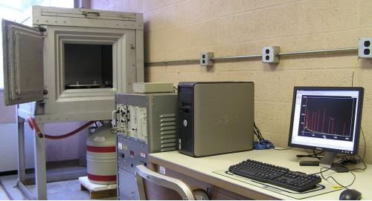
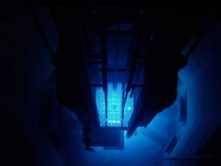
Difficulties in Geochemically Identifying Steatite Sources
Most geo-chemical steatite sourcing studies have examined bedrock outcrops, and quarries
from Appalachian Mountains or artifacts from the Eastern U.S.
Comparative base line information on NW Plains and West Coast source areas has yet to be developed.
Early sourcing attempts tried:
Mineral Petrography/Modal Mineralogy (optical identification and density of minerals);
Instrumental Neutron Activation Analysis (INAA for ID Rare Earth Elements (REE),
Inductively Coupled Plasma-Mass Spectrometry (ICP=MS) on REE and Transitional metals,
Visible/Near-Infrared diffuse Reflection Spectrometry (VNIRS) on color, texture & mineralogy.&
Electron Micro-probe Analysis (EMPA) on specific minerals, esp. amphiboles (dark chain silicates minerals) and ilmenite (iron-titanium oxide minerals).
Studies had limited success, due to:
Small sample sizes of quarries and artifacts, use of bulk samples, or imprecise/non-replicable measurements.
Quarry samples may be inferior discard tailings or rocks with heterogeneous geochemical characteristics.
Metamorphic formation processes differentially alter rare earth elements.
Micro-probe analyses are yielding promising results, but studies need to expand the range of sampled quarries.
Great variation range occurs within single quarry
Little consistency exists in developing regional comparisons.
If direct steatite sourcing is so difficult, what evidence exists suggesting northwestern-southern Plains connections?

Slide 16
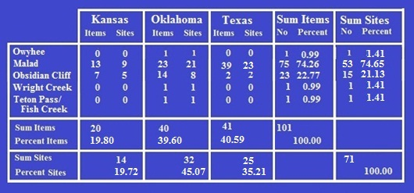
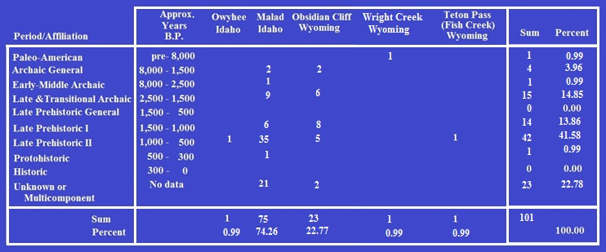
Occurrence of NW Plains obsidian on the Southern Plains
101 Specimens from five Northwest Plains obsidian sources have been found in Kansas, Oklahoma, Texas.
74% of NW obsidian are from Malad Idaho source.
Frequency of Northwest Plains Obsidian Artifacts on the Southern Plains by Period
Southern Plains obsidian dates from Middle Archaic to Proto-historic Periods.
Most common during Late Prehistoric II.
Contemporaneous with 41SS178 steatite vessel.
Cultural Period Occurrences of NW Obsidians on the Southern Plains

Slide 17
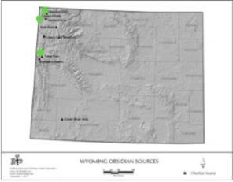
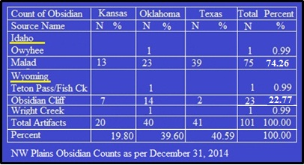
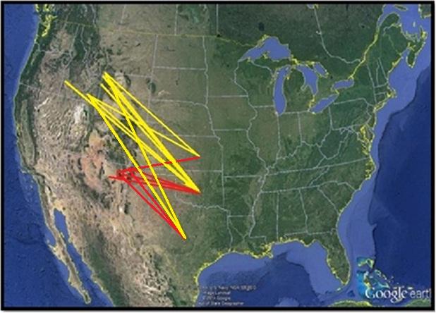
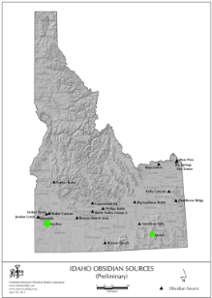
Distribution of Sourced Obsidian found in Southern Plains
Obsidian Cliff
Wright Creek
Teton/Fish Creek
Northwest Plains
Sources
Southwest
Sources
Owyhee
Malad

Slide 18
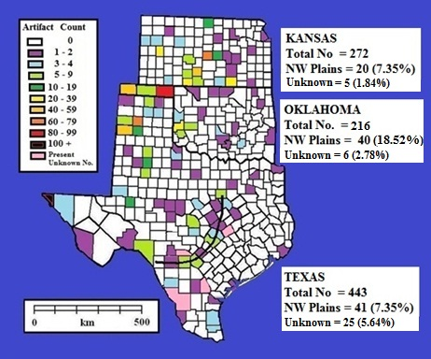
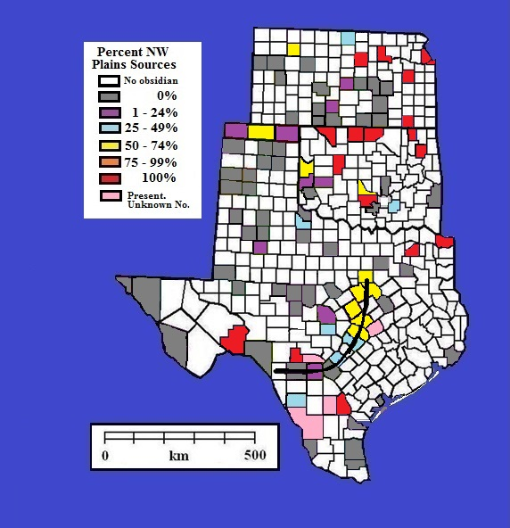
Obsidian occurrence on the Southern Plains
Frequency distribution of all sourced obsidian
artifacts on the Southern Plains
Obsidian Database = 1,387 artifacts
931 artifacts (67.1%) from KS, OK, TX.
Percent of obsidian artifacts
Per County from NW Plains Sources
Balcones Escarpment
NW Plains sources = 101 (10.8%)
Unknown sources = 36 ( 3.9%)
Balcones Escarpment

Slide 19
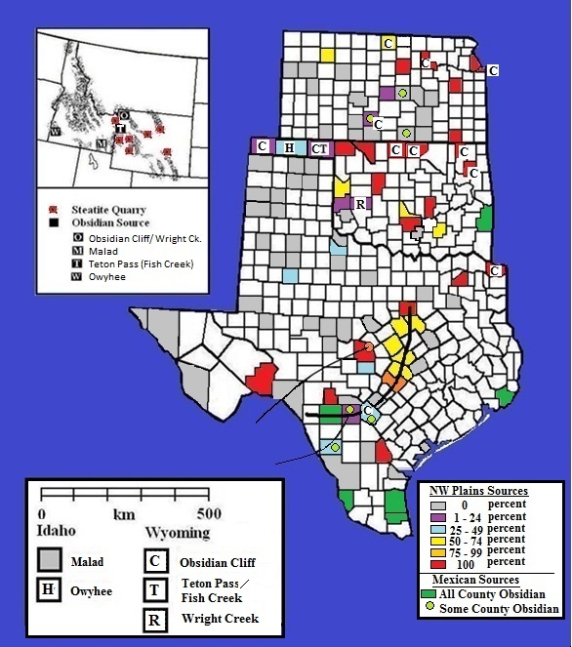
Northwest-Southern Plains Obsidian connections
Density of NW Plains obsidian found along:
1) Oklahoma panhandle
2) Mixed-Grass Prairies
3) Balcones Escarpment
Not often found on:
Short-Grass Plains
Trans-Pecos
Tall-Grass Prairies
Gulf Coast
South Texas
Highest percent usually occur in eastern counties; very rare on High Plains
41SS178
Balcones Escarpment
41SS178 Steatite Bowl
Steatite Vessel
Balcones Escarpment
Balcones Escarpment

Slide 20
Summary and Conclusions
Although steatite occurs in the Llano Uplift, prehistoric steatite artifacts in Texas are rare and consist of small sized artifact forms (pendants, pipes).
San Saba County vessel is unique to Texas. There is no evidence of steatite vessel manufacturing traditions in Texas.
Steatite vessel manufacturing traditions are common in three areas of North America:
1) the West Coast (especially California and Washington);
2) the Appalachian Mountains, (especially Georgia to Massachusetts);
3) the Northwestern Great Plains (Wyoming, Montana, Idaho).
The San Saba vessel most closely resembles the vessels from NW plains in form and time.
Long standing movement of Malad, Obsidian Cliff, and rare other obsidian sources from Wyoming and Idaho to the Southern Plains begins in Late PaleoIndian times.
Obsidian movements occur during the Paleo-Indian (1.0%), Archaic (19.2%), Late Prehistoric I/Woodland (13.9%), Late Prehistoric II/Plains Village (41.6%) and maybe into the Protohistoric (1.0%) Periods. Obsidian from unassigned periods comprise 22.8%.
Postulate that 41SS178 steatite vessel moved south using same mechanisms as obsidian.
Discontinuous distribution of NW obsidian does not reflect “Down-the-line” exchange. (expected density decline with distance from source).
Greatest density in eastern (cross timbers & woodlands) of Kansas and Oklahoma.
NW obsidian concentration in Texas hunters-gatherers-- Not for prestige differentiation.
NW Plains obsidian concentrated in select ecotonal regions on the southern Plains, usually with abundant fresh water and complex habitat mosaics.

Slide 21
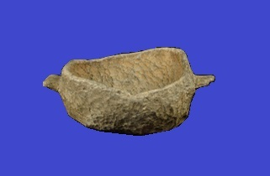
Questions?
State Museum of Pennsylvania
Acknowledgements:
For steatite sourcing issues: Dr. Jim Burton (University of Wisconsin, Madison), Dr. Kenneth Sassaman (University of Florida), Dr. Michael Glasscock (University of Missouri), Rich Adams (Office of State Archeologist, Wyoming).
For access to Texas steatite archeological examples and the siltstone bowl from 41ME147: Ms. Tiffany Osburn (Texas Historical Commission), Ms. Laura Nightengale (Texas Archeological Research Laboratory, retired).
For information on obsidian from the southern Plains: Dr. Thomas Hester (University of Texas, Austin, retired), Dr. Timothy Baugh (Division of Historic Preservation, Chickasaw Nation), Doug Boyd (Prewitt and Associates Inc.), Dr. Robert Brooks (Oklahoma Archaeological Survey), Dr. Robert Hoard (Kansas State Historical Society), and Dr. Donna Roper (Kansas State University).

