Slide 1
Introduction to Climate
It’s COLD!!
Class Over.

Slide 2
Introduction to Climate
The earth's climate is generally defined as the average weather over a long period of time.

Slide 3
Why study climate/weather
Climate is a significant factor in the development of all major aspects of the life.
Certain ecosystems (a system of interconnecting and interacting parts) attract people.
What was available for civilizations to last/develop?
Levels of economic growth

Slide 4
Primary economic activities are those that use natural resources directly and these economic activities are located at the site. The economy is dominated by subsistence activity where output is consumed by producers rather than traded. Any trade is carried out by barter where goods are exchanged directly for other goods. Agriculture is the most important industry and production is labor intensive using only limited quantities of capital.

Slide 5
Secondary economic activities use raw materials to produce or manufacture something new and of monetary value. Examples of secondary economic activities include manufacturing steel, processing wheat into flour, milling lumber into plywood, iron smelting, chemical industries, power production, and construction. Activities are located either at the site of the resource or close to the market for the manufactured/processed good. In the case of lumbering, the finished product is cheaper to ship than shipping the raw materials to the lumber mills so the lumber mills are located close to forests to minimize costs (and maximize profit). In the case of flour and bread, it is cheaper (and easier) to ship wheat than the finished product, bread. Consequently, bakeries are located close to consumers in cities, again, to minimize costs. These activities fueled the Industrial Revolution.

Slide 6
Tertiary economic activities are those activities which provide services, personal and professional services such as doctors, teachers, dry cleaners, and secretaries as well as retail and wholesale services such as store clerks, truck drivers, and fast-food providers. These activities are located where services are required, that is where people are.

Slide 7
Quaternary. In modern economies some individuals process, administer, and disseminate information. Such activities are termed quaternary which is used to describe "white collar" professionals working in education, government, management, information processing, and research. These activities are not tied to resources, the environment, or access to a market. With improvements in telecommunications, these economic activities can be located anywhere. Factors which do tend to affect the location of "high-tech" economic activities include access to universities and research centers and to a pool of highly trained and skilled workers, availability of venture capital, proximity to places with high quality of life attributes (scenery, recreation, climate, quality education system) and access to excellent transportation and communication networks.

Slide 8
It is the climate that attracts people to a location
and
the weather that makes them leave.

Slide 9
Climate is what you expect,
weather is what you get!!!!

Slide 10
day-to-day weather conditions
Hot
Cold
Wet
Dry
Wind
Come up with and average

Slide 11
Two Principle Elements of Climate
  Temperature,
  Humidity/ Precipitation

Slide 12
Controls on climate
  Latitude, Land/Water distribution, Geographic Position
  Ocean Currents
  Pressure
  Mountains

Slide 13
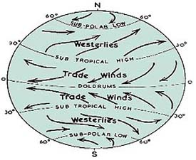

Slide 14
Wind
The prevailing wind systems of the earth blow from high pressure toward adjacent low-pressure belts.
earth's rotation deflect air to the right in the Northern Hemisphere and to the left in the Southern Hemisphere
The heating and cooling of the air due to rotation and revolution of the earth creates wind daily and seasonally
modified by the distribution of land and water, especially in the temperate regions, where temperature differences between land and water are greatest.

Slide 15
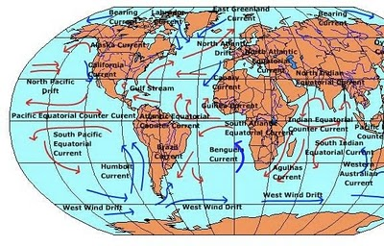

Slide 16
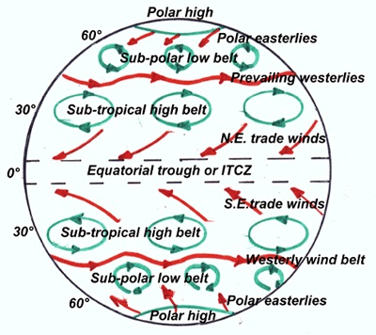

Slide 17
Air Pressure
atmospheric or air pressure is the force per exerted on the Earth’s surface by the weight of the air above the surface.
created by the molecules, their size, motion, and number present in the air.
they determine the temperature and density of the air and thus its pressure.

Slide 18
Low Pressure
Lows are usually associated with high winds, warm air, and atmospheric lifting. Because of this, lows normally produce clouds, precipitation, and other bad weather such as tropical storms and cyclones.
do not have extreme diurnal (day vs. night) nor extreme seasonal temperatures because the clouds present over such areas reflect incoming solar radiation back into the atmosphere so they cannot warm as much during the day (or in the summer) and at night they act as a blanket, trapping heat below.

Slide 19
High Pressure
Air moves clockwise in the northern hemisphere and counterclockwise in the southern due to the Coriolis Effect.
as the air in the high cools it becomes denser and moves toward the ground and evaporates most of the atmosphere's water vapor so high pressure systems are usually associated with clear skies and calm weather.
the absence of clouds means extremes in diurnal and seasonal temperatures since there are no clouds to block incoming solar radiation or trap outgoing radiation at night.

Slide 20
Seasonally
  In winter, areas of high pressure tends to build up over cold continental land masses, while low-pressure development takes place over the adjacent, relatively warm oceans.
  Exactly the opposite conditions occur during summer, although to a lesser degree. These contrasting pressures over land and water areas are the cause of monsoon winds.

Slide 21
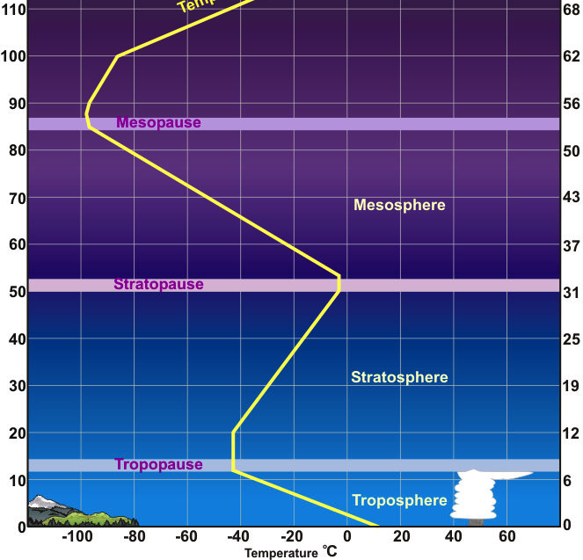

Slide 22
All weather occurs in the Troposphere
Atmosphere is made up of 78% nitrogen and 21% oxygen
  Nitrogen is added to the air by decaying or burning organic matter and cleared out of the air by rain and snow. the addition and removal of nitrogen is in balance and remains constant.
  Oxygen is produced by vegetation and is removed by a variety of organic and inorganic processes
*These gases have little to no affect on weather/climate
Variable gasses- (other gasses)available in the atmosphere in parts per million and yet have significant affect on weather/climate.
    Water vapor (H20)
    Carbon Dioxide
    Carbon Monoxide
    Methane
    Ozone
    Sulfur dioxide
    Nitrogen dioxide

Slide 23
Water vapor (H20)– distribution is variable, amount consistent
* source of clouds and precipitation and plays important roles in a number of heating and cooling processes
  * most abundant over warm moist surfaces least over cold dry areas-
(Amazon vs Atacama Desert)
Carbon Dioxide (CO2)– historically distributed uniformly until the burning of fossil fuels and now is becoming more concentrated
* it’s affect on weather is its ability to absorb infrared radiation

Slide 24
Ozone (O3)
  is made of three oxygen atoms
  Ozone is constantly being formed in the earth's atmosphere by the action of the sun's ultraviolet radiation on oxygen molecules
  Ultraviolet light splits the molecules apart by breaking the bonds between the atoms. A highly reactive free oxygen atom then collides with another oxygen molecule to form an ozone molecule. Because ozone is unstable, ultraviolet light quickly breaks it up, and the process begins again. It is a constant process.
  Ozone and oxygen molecules in the stratosphere absorb ultraviolet light from the sun, providing a shield that prevents this radiation from passing to the earth's surface.
  Only ozone effectively absorbs the most energetic ultraviolet light, known as UV-C and UV-B, which causes biological damage.
  The protective role of the ozone layer in the upper atmosphere is so vital that scientists believe life on land probably would not have evolved - and could not exist today - without it.

Slide 25
  This chemical processes maintains a dynamic equilibrium that keeps the overall amount of ozone constant - that is, IF humans did not contribute to the chemical processes.
  About 90% of the ozone in the earth's atmosphere lies in the stratosphere.
  Only 10% of the ozone in the earth's atmosphere is found in the troposphere,
  But even in such small doses, this molecule can do a lot of damage.
  it becomes a greenhouse gas because it absorbs heat
*How is the ozone destroyed
  CFCs, HCFCs, carbon tetrachloride, methyl chloroform, and other gases release chlorine atoms, and halons and methyl bromide release bromine atoms
  It is these atoms that actually destroy ozone.
  It is estimated that one chlorine atom can destroy over 100,000 ozone molecules
  This removes ozone faster than natural ozone can be created and changes the reactions

Slide 26
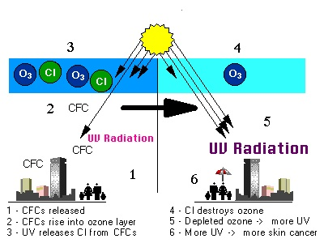

Slide 27
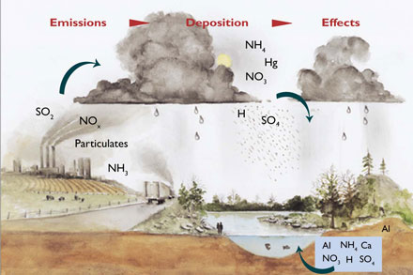

Slide 28
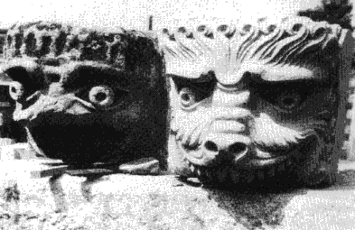

Slide 29
Particulates- solid and liquid particles found in the atmosphere
  Sources-
    Natural – volcanic ash, windblown soil, pollen grains, meteor debris, smoke from wildfires, salt spray
    Human source – industrial emissions, automotive emissions, smoke and soot from human introduced fires
      All are hazardous to life and have some effect on climate. (Methane absorbs certain wavelengths of radiation and therefore plays with temperature.) (sulfur dioxide (SO2)- from factories)
How do they affect weather/climate
  some absorb water (hydroscopic) or particulates adhere to water droplets creating rain. Some
  reflect or absorb light thus affecting temperature

Slide 31
Primary Natural Forces
El Nino
  a giant pool of warm water that normally sits in the central Pacific surges all the way to South America
  La Nina
  shrinks and retreats into the western Pacific.

Slide 32
TEXAS
Texas has more diverse weather on a typical day than any other state within the union—with the possible exception of California.
Due not only to its inordinate size, but also to its strategic position on the North American continent.
Gulf of Mexico is the predominant geographical feature affecting the state’s climate
  moderating seasonal temperatures along the Gulf Coast and more importantly
  providing the major source of precipitation for most of the state

Slide 33
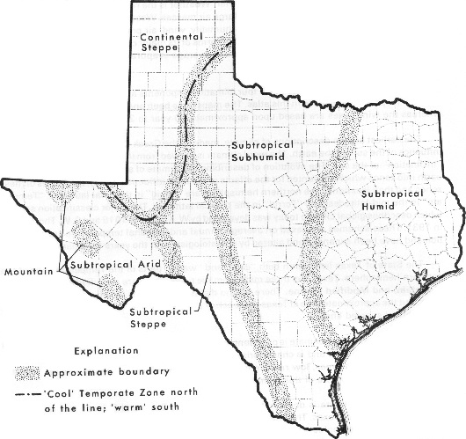

Slide 34
The state of Texas lies within both "cool" and "warm" parts of the Temperate Zone of the Northern Hemisphere. Texas has three major climatic types that are classified as Continental, Mountain, and Modified Marine. There are no distinct boundaries which divide these climate types, but the approximate area of Texas that each encompasses is indicated on the following map by the broad stippled lines.
· The eastern third of Texas has a Subtropical Humid climate that is most noted for warm summers.
· The central third of Texas has a Subtropical Subhumid climate characterized by hot summers and dry winters.
· The broad swath of Texas from the mid-Rio Grande Valley to the Pecos Valley has a Subtropical Steppe climate and is typified by semi-arid to arid conditions.
· The basin and plateau region of the Trans-Pecos features a Subtropical Arid climate that is marked by summertime precipitation anomalies of the mountain relief.
· A Mountain type climate is common in the higher elevations of the Guadalupe, Davis and Chisos Mountains.

Slide 35
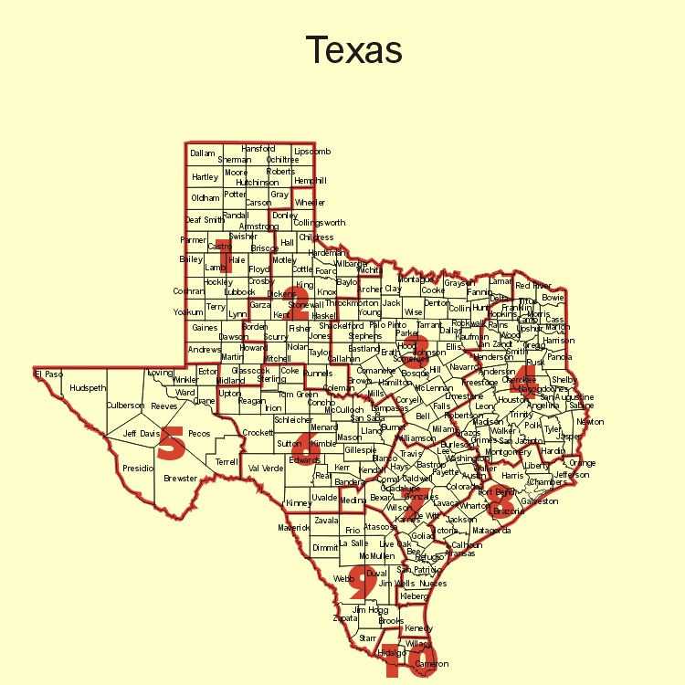

Slide 36
The National Climatic Data Center divides Texas into 10 climate divisions Climate divisions represent regions with similar characteristics such as vegetation, temperature, humidity, rainfall, and seasonal weather changes.
Division 1 (High Plains): Continental steppe or semi-arid savanna
Division 2 (Low Rolling Plains): semi-arid savanna
Division 3 (Cross Timbers): Sub-tropical sub-humid mixed savanna and woodlands
Division 4 (Piney Woods): Sub-tropical humid mixed evergreen-deciduous forestland
Division 5 (Trans-Pecos): Except for the slightly wetter high desert mountainous areas, sub-tropical arid desert
Division 6 (Edwards Plateau): Sub-tropical steppe or semi-arid brushland and savanna
Division 7 (Post Oak Savanna): Sub-tropical sub-humid mixed prairie, savanna, and woodlands
Division 8 (Gulf Coastal Plains): Sub-tropical humid marine prairies and marshes
Division 9 (South Texas Plains): Sub-tropical steppe or semi-arid brushland
Division 10 (Lower Rio Grande Valley): Sub-tropical sub-humid marine

Slide 37
Precipitation-
  Average annual precipitation decreases as it moves westward over the coastal plain and successively reaches the Balcones Escarpment, the Edwards Plateau, and the mountains of the Trans-Pecos.
    from over 56 inches in Beaumont to less than 8 inches in El Paso (east to west)
    Precipitation in the Trans-Pecos and the Panhandle regions of Texas originates mostly from the eastern Pacific Ocean and from convection.

Slide 39
Temperatures
  Average annual temperature gradually increases from about 54°F in the northern Panhandle of Texas to about 78°F in the Lower Rio Grande Valley (north to south)
  Changes with change in latitude and distance from the Gulf

Slide 40
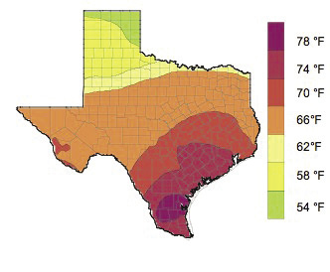

Slide 41
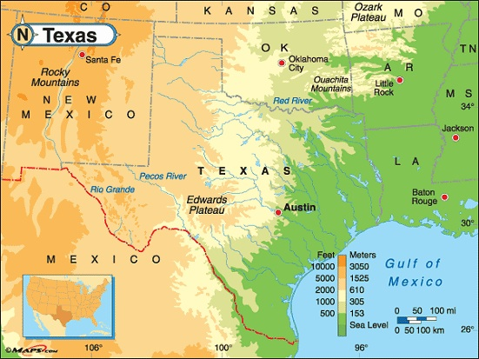

Slide 42
Wind
Average wind speed in TX varies from 7 to 15 MPH
In the southern half of TX where cool fronts often do not extend, winds are out of the south.
  Texas is within reach of the migration of cool air from Canada and the inevitable interaction of air masses of varying densities.
    The Rocky Mountains guide polar fronts of cold arctic air southward into the state during the fall, winter, and spring.

Slide 43
Pressure
TX is located where there is a semipermanent subtropical high
High pressure is associated with cool temp. but remember it is relative to surrounding temps

