Slide 1
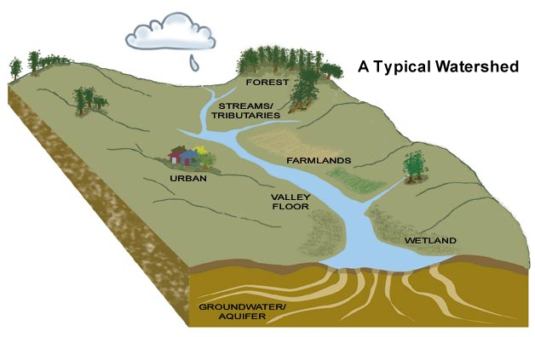
Lindheimer Chapter 2025 TEXAS WATERS SPECIALIST CERTIFICATION CLASSES
Chapter 2: Characteristics, Components & Value of Healthy Watershed Ecosystems
Chapter 3: The Watershed’s Role as a Natural System

Slide 2
Guadalupe River
https://youtu.be/wvMXhHwjB6Y (9:19) Underwater fish cam in the Guadalupe

Slide 3
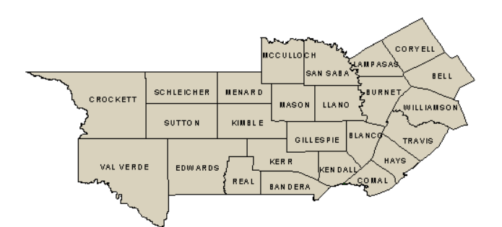
Comal County: Gateway to the Texas Hill Country

Slide 4
Chapter 2 & 3 Questions to Consider
What connections exist between climate, geomorphology, hydrology and healthy watershed ecosystems?
What can the biodiversity of a given ecosystem tell us about its health?
How does the structure of a watershed determine its plant and animal life?
What is the significance of identifying keystone and indicator species?
What is the primary role that flowing water plays in a watershed?
Is erosion a bad thing?
How do watersheds use the various nutrients that pass through them, and what role do they play in trophic interactions?

Slide 5
Chapter 2 & 3 Challenge Activities
Identify and order the different streams in your watershed
Locate the primary stream channel that flows into the Gulf of Mexico
Look around the area where you live for signs of the transportation and storage roles water plays. Do they represent natural functions or are they reflective of human- caused changes in the landscape and watershed?

Slide 6
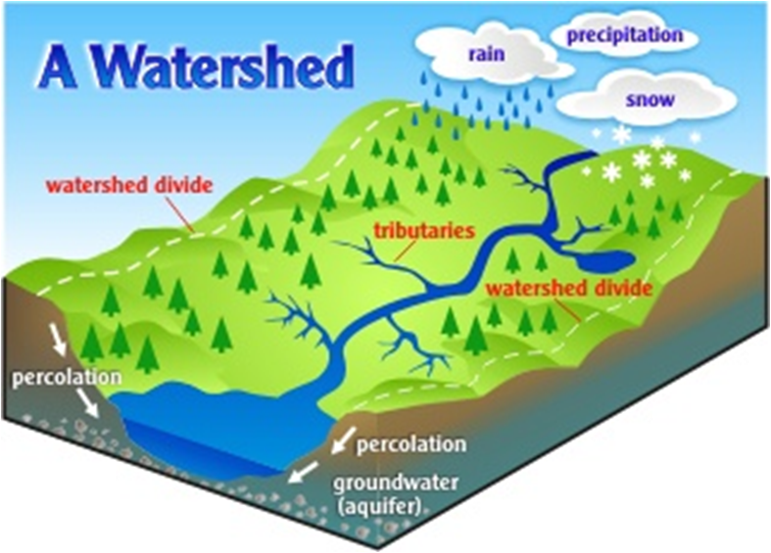
What is a watershed? An area of land where all water (surface & groundwater) flows to the lowest point - usually a lake, river, or stream.

Slide 7
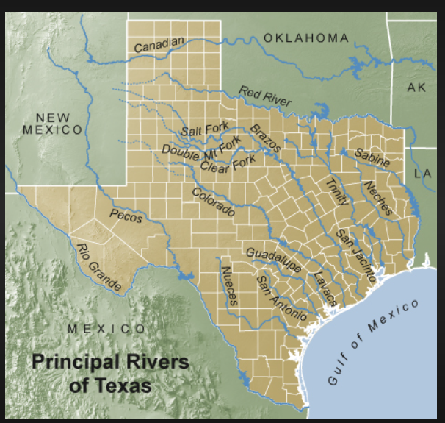

Slide 8
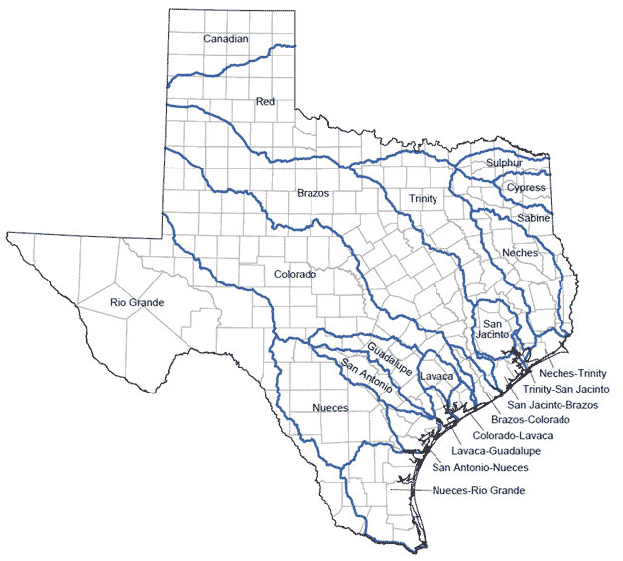
Texas River Basins

Slide 9
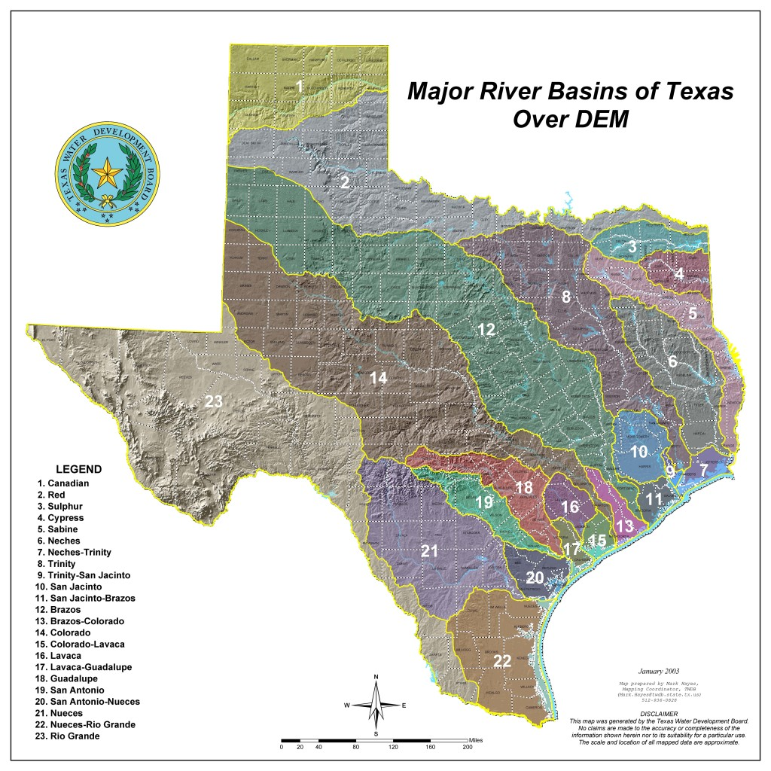
Texas River Basins

Slide 10
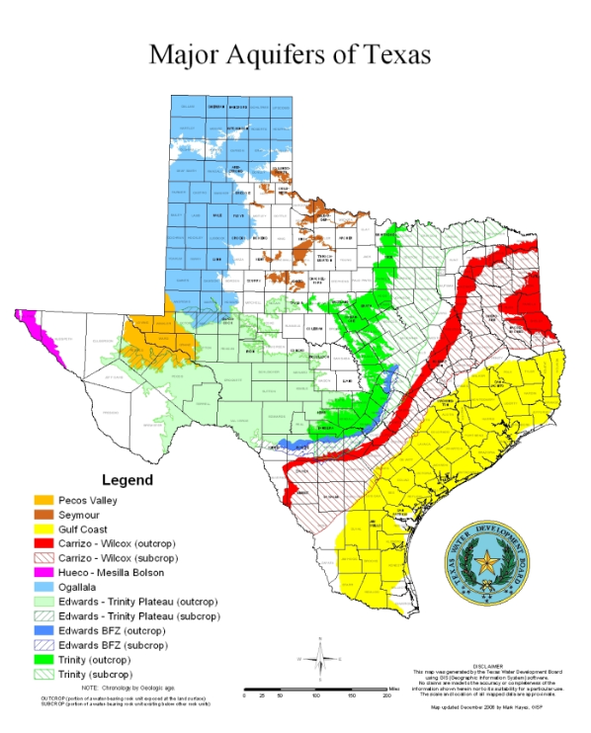
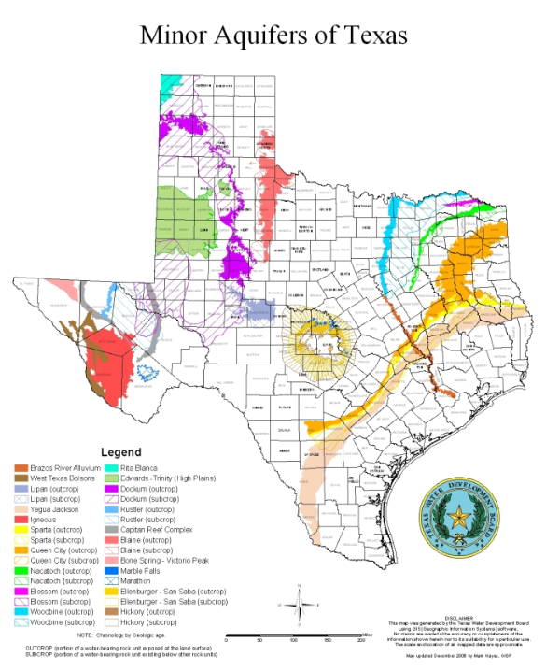

Slide 11
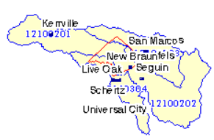
Find your watershed
https://tpwd.maps.arcgis.com/apps/Viewer/index.html?appid=2b3604bf9ced441a98c500763b8b1048

Slide 12
Challenge
Look around the area where you live for signs of the transportation & storage roles of water. Do they represent natural functions or are they reflective of human- caused changes in the landscape and watershed?

Slide 13
Texas had only one natural lake, Caddo Lake in East Texas, that was formed by a log jam. A permanent dam was installed at the lake in the early 20th century.
Texas’ early history is filled with accounts of devastating floods causing loss of human life and destroying livestock and property, particularly along the Brazos. As a result, in the 1930s and 40s, officials began building dams along Texas rivers to create flood control reservoirs that would absorb the floodwaters and alleviate damage and loss of life.
Momentum for such flood control projects picked up during the 1950s and the US Army Corps of Engineers was tasked with building several more reservoirs for flood control over the next several decades. Ironically, the worst drought of record for Texas took place during the 1950s, prompting emphasis on a second priority for these reservoirs: water supply.

Slide 14
Tracing a Texas River: The Guadalupe (6:00)
https://youtu.be/GBG_VeMlPds
https://wordcc.com/take-a-trip-through-our-virtual-river-guide/

Slide 15
Natural Resources Conservation Service (NRCS) Responsible for the Watershed Protection & Flood Prevention Program
Assisted watershed sponsors in construction of nearly 2,000 floodwater retarding structures (dams) in 145 watershed projects across Texas.
In addition, the NRCS has assisted watershed sponsors with the installation of land treatment practices, channel improvements, and dikes for watershed protection.
Results (as of 2013)
Texas watershed projects:
provide over $150 million in annual benefits. Besides flood protection,
6,200 bridges are protected, as well as numerous county, state, and federal highways.
Over 11 million tons of sediment is stored annually, therefore preserving over 10,000 ac-ft of storage in downstream reservoirs and water supplies.
These dams also provide an additional 60,000 acres of created, enhanced, or restored wetlands, as well as numerous other social benefits.

Slide 16


Slide 17
Watershed Ecosystem
A watershed ecosystem is the interplay of living (biotic) and non-living (abiotic) components in a land area that drains to a stream, lake, river
Ecosystem functioning:
reflects the collective life activities of plants, animals, and microbes
reflects the activities and the impact their effects (feeding, growing, moving, excreting waste, etc.) have on the physical and chemical conditions of their environment.
exhibits biological and chemical activities characteristic for its type.

Slide 18
Watershed Components
Abiotic (non-living)
Climatology - Weather is daily; climate is over time
Geomorphology – Shape of the land
Hydrology – Water in all its forms
Biotic (living)
Food Webs
Producers: Generate food through photosynthesis (plants)
Consumers: Vegetarians are 1st Order Consumers 2nd Order Consumers feed on 1st Order, etc., on up the food chain
Decomposers: Feed on dead tissue and return nutrients and energy to other parts of the cycle - Example
Trophic Ecology (feeding patterns)

Slide 19
Functions of a Watershed A watershed system must be able to balance the influx of water in such a way as to optimize watershed function.
Hydrological Functions
Ecological Functions
Capturing Water
Water capture is the process by which water from the atmosphere is captured or stored in the soil
Storing Water
Once water is captured in the soil, it is stored in the pores (air spaces) between soil particles, depending on the soil’s depth, texture and structure. Clay soil holds the most water.
Releasing Water:
Water is released from a watershed when it moves through the soil profile to seeps and springs, or across the land surface as runoff, and ultimately into streams and rivers that flow to oceans. Water is safely released when it moves out of the watershed without causing environmental problems.
Providing diverse sites for biogeochemical reactions to take place.
Nutrient elements such as nitrogen, sulfur, phosphorus, carbon and hydrogen, and organic materials containing these nutrients, are constantly undergoing biological, physical and chemical reactions with the surrounding environment. Plants and microbes, in turn, fuel additional reactions and biogeochemical cycling. These communities also help maintain the global atmosphere through a complex cycle in which carbon is trapped in plant biomass, preventing its release into the atmosphere as carbon dioxide, a greenhouse gas.
Providing habitat for native plants and animals of various kinds.
A healthy habitat contains everything a species needs to survive—food, water, cover, and a place to raise young. Because different living things have different needs for food, water and cover, each kind of plant and animal requires a specific kind of habitat.

Slide 20
Healthy Watershed Characteristics
A healthy watershed is one in which natural land cover supports:
dynamic hydrologic and geomorphologic processes within their natural range of variation,
habitat of sufficient size and connectivity to support native aquatic and riparian species
physical and chemical water quality conditions able to support healthy biological communities
A healthy watershed has the structure and function in place to support healthy aquatic ecosystems. Key components of a healthy watershed include:
intact and functioning headwater streams, floodplains, riparian corridors, biotic refugia (an isolated place of relative safety from danger and hardship; the only remaining high quality habitat within an area) instream habitat and biotic communities;
natural vegetation in the landscape; and
hydrology, sediment transport, fluvial geomorphology, and disturbance regimes expected for its location.

Slide 21
Take a break! Drink some water! ☺

Slide 22
The Power of Water…
https://youtu.be/L7-xp-LV8XQ Canyon Lake Gorge (1:30)
https://youtu.be/klqh45EJJss Wimberly Flood 2015 (3:28)

Slide 23
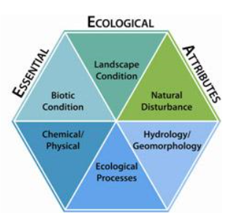
How can you tell if a watershed is healthy?
Environmental Protection Agency Healthy Watershed Program
https://www.epa.gov/hwp/integrated-assessment-healthy-watersheds
There are literally hundreds of watershed characteristics (such as environmental traits, sources of degradation, and community factors) that may influence environmental health and quality of life, for better or worse. Identifying and comparing these characteristics is known as watershed assessment. This process is the main way to compare watershed condition across large areas such as states, and find the healthy watersheds among the rest.

Slide 24
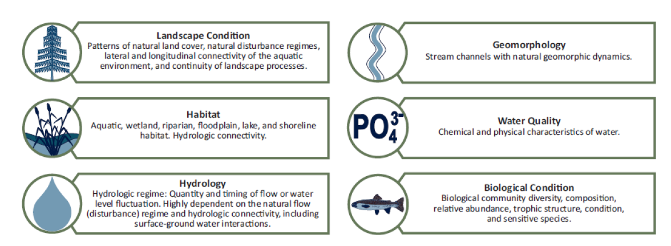

Slide 25
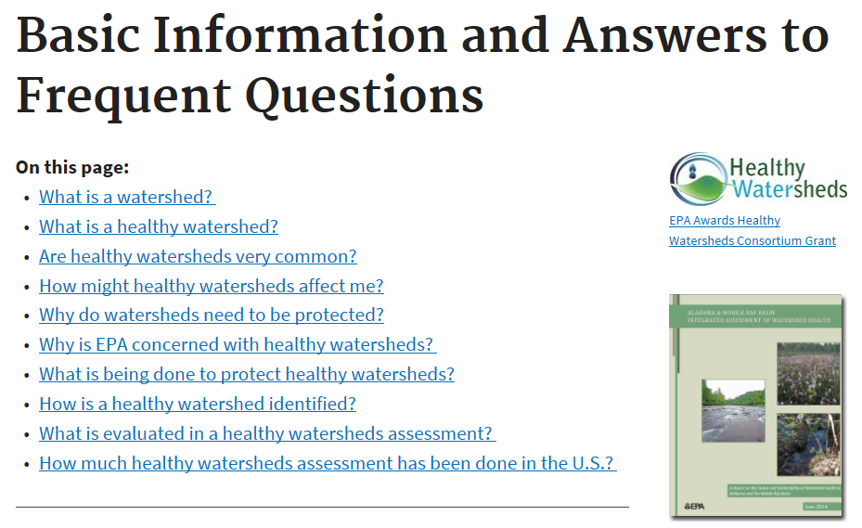
https://www.epa.gov/hwp/basic-information-and-answers-frequent-questions#common

Slide 26
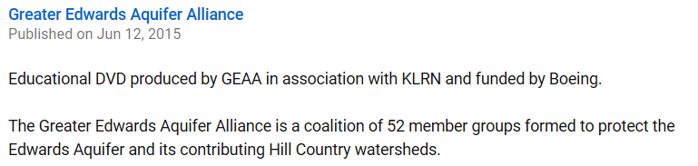
https://www.youtube.com/watch?v=Yi3cWwUA0rg Human Effect on the Edwards Aquifer (4:57)

Slide 27
The Importance of Biodiversity to the Watershed
Categories of Biodiversity
Genetic
Population
Species
Things We Know About Biodiversity
Human impacts on global biodiversity have resulted in losses in global biodiversity from genes & species to entire ecosystems
Local declines in biodiversity are even more dramatic – the beneficial effects of many organisms on local processes are lost long before the species become globally extinct
Many ecosystems are sensitive to declines in biodiversity
Changes in the identify and abundance of species in an ecosystem can be as important as changes in biodiversity in influencing ecosystem processes

Slide 28
Species Function in a Watershed
Keystone: A species that has an important, even critical effect on the configuration of communities and ecosystem function; almost a disproportionate effect even if numbers are small
Dominant: Most abundant species
Indicator: First to show evidence of environmental change
“The canary in a coal mine”
Presence or absence indicates degree of healthiness

Slide 29
Comal County/Hill Country Species
What is the…
Dominant species?
Indicator species?
Keystone species?

Slide 30
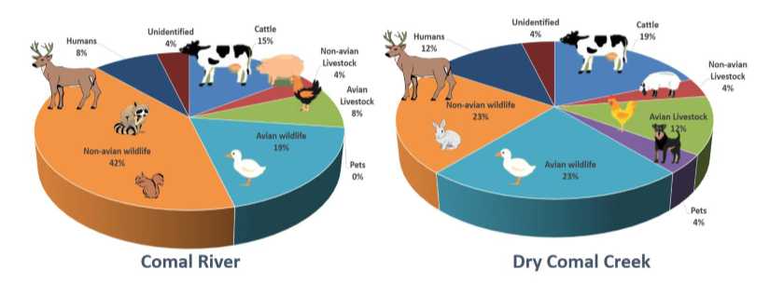
From: Dry Comal Creek and Comal River Watershed Protection Plan (Draft- 6/2017)

Slide 31
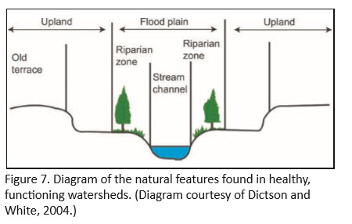
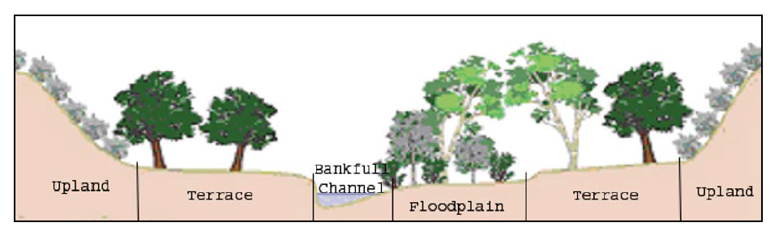
Natural Watershed Features
Natural Watershed Features
An upland is an area of land located at a higher elevation above a water body. Uplands typically form watershed boundaries, or divides. Upland areas:
Provide important habitat for mammals, birds, reptiles and amphibians
Stabilizes the soil surface, minimizes surface erosion
Filters and retains dissolved and suspended matter carried by surface water runoff from the surrounding land
The floodplain is the flat area of land surrounding a body of water that is subject to periodic flooding.
After heavy rainfalls, the floodplain holds excess water, allowing it to be slowly released into the river system or seep into groundwater aquifers. Floodplains also help to
Filter out sediment from floodwaters, thereby keeping it out of water bodies.
Floodplains often support an abundance of aquatic life and are often used as recreation areas.

Slide 32
https://www.youtube.com/watch?v=ButQspZX2yA Watersheds, Rivers and Floodplain
Watersheds, Rivers and Floodplain
(7:57 minutes)
This video will cover the definition and identification of watersheds; the definition and description of rivers, including the floodplains of rivers, and; the beneficial functions of floodplains.

Slide 33
Tour of the Guadalupe River
https://tours.fishviews.com/public/guadalupe-river#0

Slide 34
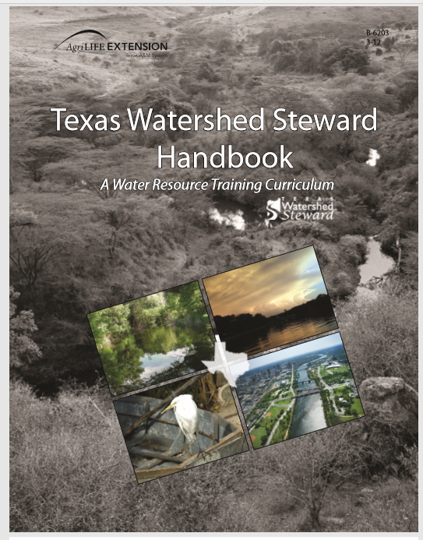

Slide 35
The State of Texas Water: Complicated!

Slide 36
Texas Water Development Board (TWDB) http://www.twdb.texas.gov/
Supports the development of regional water plans and incorporates them into a state water plan for the orderly and responsible development, management, and conservation of the state's water resources;
Provides loans to local governments for water supply projects; water quality projects, including wastewater treatment and nonpoint source pollution control; flood control projects; agricultural water conservation projects; rural and small community water and wastewater projects; and expenses related to administering groundwater conservation districts;
Provides grants and loans for the water and wastewater needs of the state's economically distressed areas;
Provides agricultural water conservation and water-related research and planning grants;
Conducts studies of the occurrence, quantity, quality, and availability of the state's surface water and groundwater;
Collects data and conducts studies concerning the freshwater needs of the state's bays and estuaries; and
Maintains a centralized data repository of information on the state's natural resources called the Texas Natural Resources Information System (TNRIS) and manages the Strategic Mapping (StratMap) Initiative.
Created in 1957, the mission of the Texas Water Development Board (TWDB) is to provide leadership, information, education, and support for planning, financial assistance, and outreach for the conservation and responsible development of water for Texas. A full-time, three-member Board appointed by the governor considers loan applications from eligible applicants, awards grants for water-related research and planning, and conducts other TWDB business, such as approving the state water plan. Current functions:

Slide 37
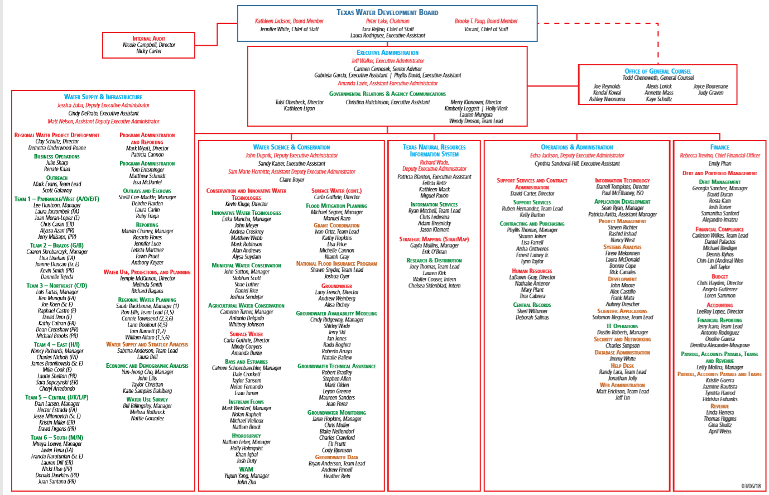

Slide 38
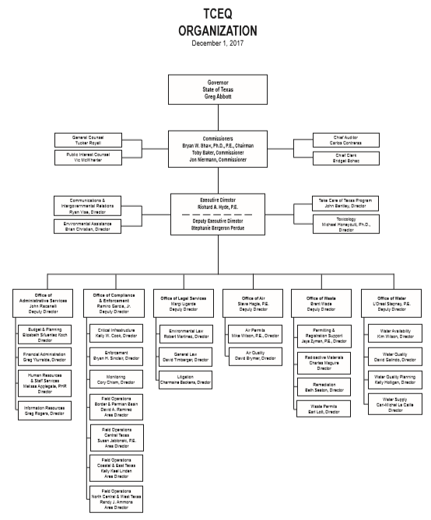
Texas Commission on Environmental Quality https://www.tceq.texas.gov/
The Texas Commission on Environmental Quality strives to protect our state's public health and natural resources consistent with sustainable economic development. Our goal is clean air, clean water, and the safe management of waste.

Slide 39
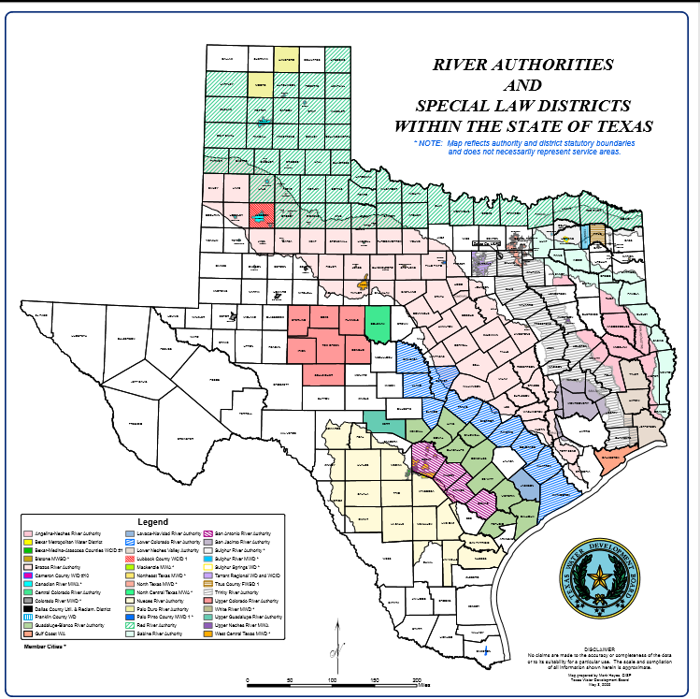
Texas River Authorities N = 24
River authorities in Texas are established by the state legislature and given authority to develop and manage the waters of the state.
These authorities are given powers to conserve, store, control, preserve, utilize, and distribute the waters of a designated geographic region for the benefit of the public.

Slide 40
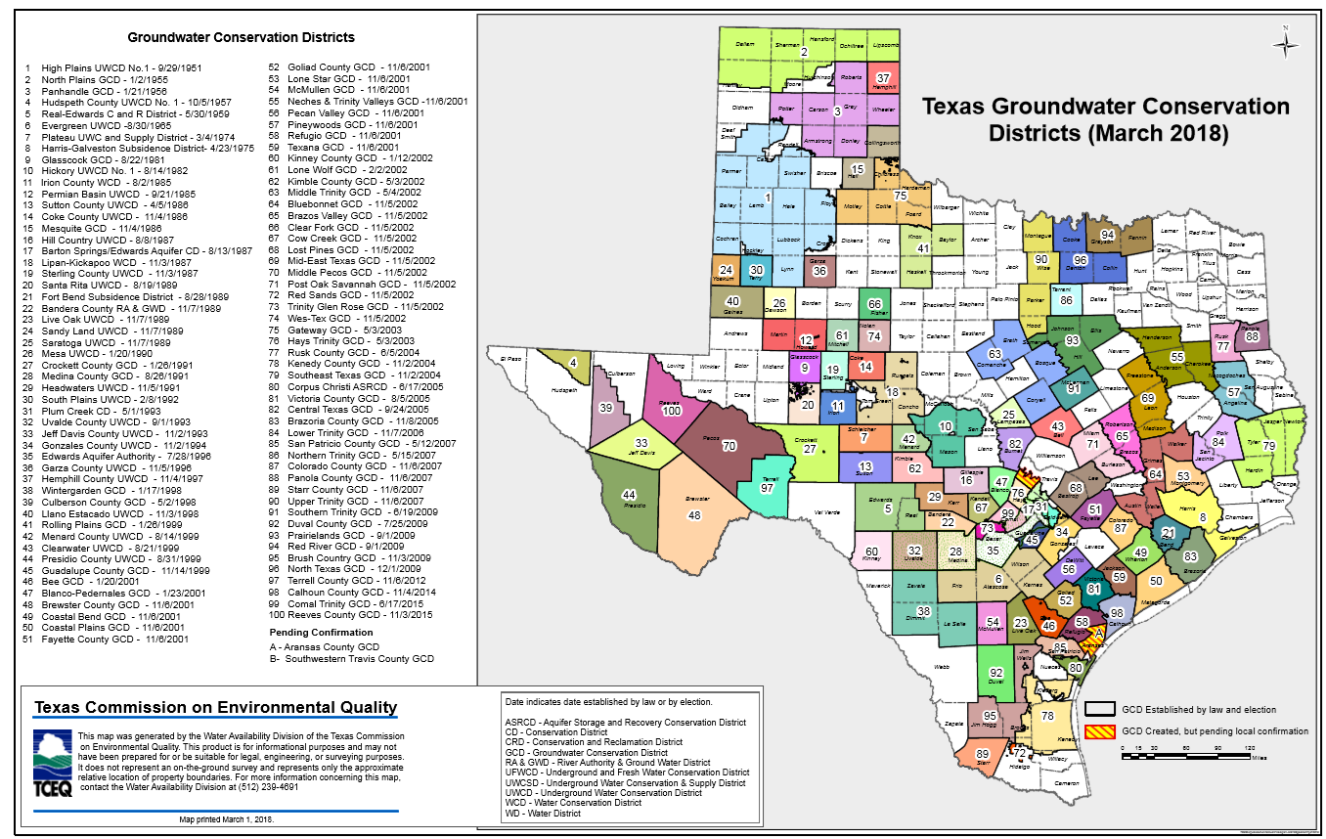
Texas Ground Water Conservation Districts N = 100

Slide 41
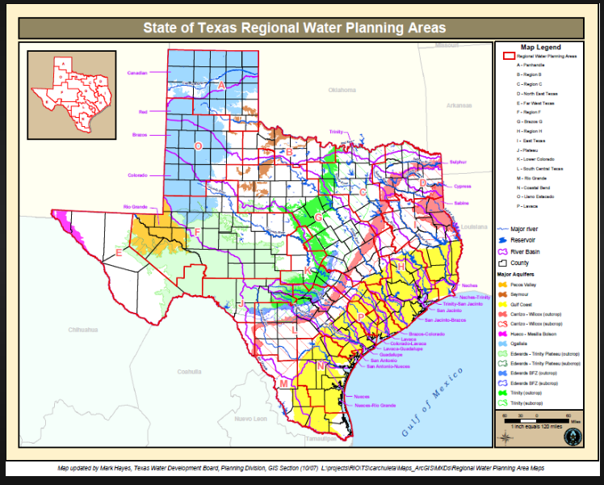

Slide 42
Texas State Soil & Water Conservation Board
The Texas State Soil and Water Conservation Board (TSSWCB) is the state agency that administers Texas’ soil and water conservation law and coordinates conservation and nonpoint source water pollution abatement programs throughout the state. Headquartered in Temple, the agency offers technical assistance to the state’s 216 soil and water conservation districts (SWCDs).
A seven-member state board governs the TSSWCB and is composed of two governor appointees and five landowners elected from across Texas by the more than 1,000 local SWCD Directors. On April 26, 2017, Governor Greg Abbott appointed Tina Buford, Texan by Nature’s board president, to the Texas State Soil and Water Conservation Board.
The TSSWCB is the lead state agency for the planning, management, and abatement of agricultural and silvicultural (forestry) nonpoint source water pollution, and administers the Water Supply Enhancement Program. The TSSWCB maintains regional offices in strategic locations across the state to manage these responsibilities.

