Slide 1

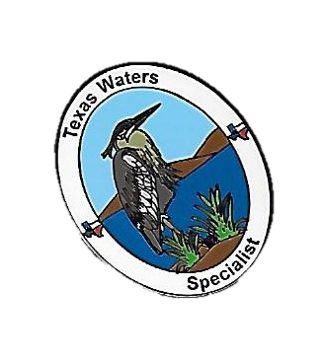
2025 Lindheimer Chapter
Chapter 7: Natural Instruments of Watershed Change
Chapter 8: Human Caused Instruments of Watershed Change
Marilyn J McFarland
Certified Texas Master Naturalist
Certified Texas Waters Specialist

Slide 2
Chapter 7: Natural Instruments of Watershed Change
Flooding
Drought
Fire
Windstorms
Erosion & Sediment Deposit

Slide 3
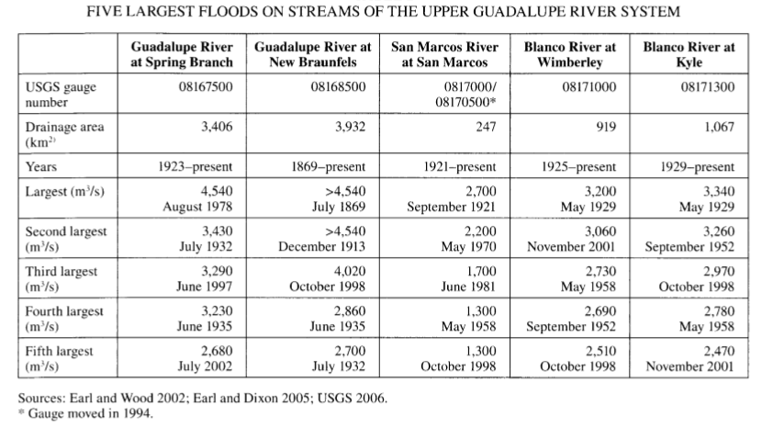

Slide 4
Drought

Slide 5
Fire

Slide 6
Windstorms

Slide 7
Erosion & Sediment Deposits

Slide 8
Human Caused Change to Watersheds
Modification of river flow
Agriculture
Timber harvest
Urbanization
Fire Suppression
Mining/Fracking
Harvesting of fish & wildlife
Introduction of exotic species
Accelerated climate change
Human population & development
Non-point source of pollution
What are the top 3
that affect the Guadalupe Watershed?
Notes:
Here are the human interventions and actions which have an impact on watersheds. Which do you think are the top 3 in Comal County?

Slide 9
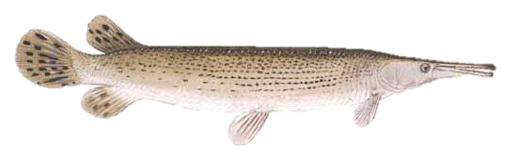
1. Modification of river flow by damming
Alters natural flow regimes
Alters temperature regimes – Affects food supply, breeding & nursery habitats of aquatic life
Increases baseflow variation – Creates extreme ranges in habitat conditions, which may be beyond aquatic life tolerance
Decreases mass transport of materials downstream – Creates sediment traps; prevents periodic “cleaning” of river & downstream re-supply
Creates a break in connectivity between stream & backwater habitats, for example, the alligator gar

Slide 10
NATURAL FLOW
Goodbye to a River by John Graves
NATURAL FLOW: Variations in magnitude, frequency, duration, timing, and rate of change in flow conditions which then…
Move sediment, woody debris & other materials downstream
Scour out vegetation
Transport seeds & plants
Provide breeding conditions for aquatic organisms
Define & organize the river ecosystem’s physical structure & environment

Slide 11
2. Agriculture/Timber Harvest
Land clearing/timber harvest – Allows erosion, run-off; creates land instabilities (e.g. Oso, Washington)
Soil tillage – Removes anchoring plants, disrupts beneath soil communities needed for supporting services functions
Grazing – Shift grassland vegetation to dominance by inedible species; denudes & degrades stream banks; increases bacteria load from manure (wildlife)
Fertilizers – Oversupply of NO³, PO⁴ with increased primary production (eutrophication) & depletion of dissolved O² d/t decomposition of excess organic matter
Pesticides – Introduce toxins into the water supply; kills outright, or destroys the food chain
Irrigation practices – Dewater streams
Notes:
Land clearing: Allows erosion, run-off; creates land instabilities (e.g. Oso, Washington) Lee Benda, a University of Washington geologist, wrote that tree removal could increase soil water “on the order of 20 to 35 percent” — and that the impact could last 16-27 years, until new trees matured. Benda looked at past slides on the hill and found they occurred within five to 10 years of harvests [i.e. felling trees for timber].
Soil tillage: Removes anchoring plants, disrupts beneath soil communities needed for supporting services functions
Grazing: Shift grassland vegetation to dominance by inedible species; denudes & degrades stream banks; increases bacteria load from manure (wildlife)
Fertilizers: Oversupply of NO³, PO⁴ with increased primary production (eutrophication) & depletion of dissolved O² d/t decomposition of excess organic matter
Pesticides: Introduce toxins into the water supply; kills outright, or destroys the food chain
Irrigation practices – Dewater streams

Slide 12
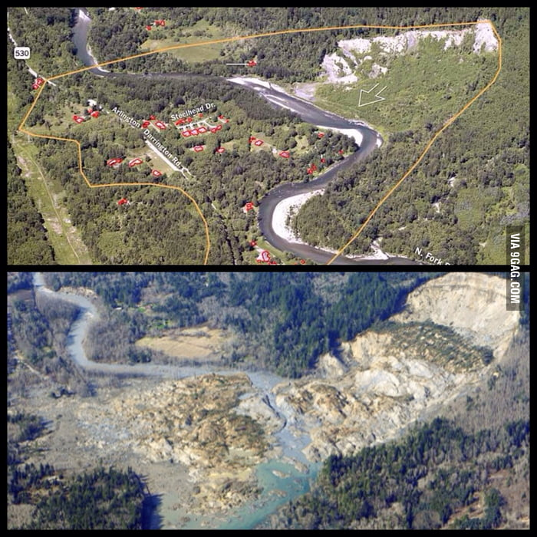
Oso, Washington at the
Stillaguamish River
Before and After Mud Slide of 2014
The mud, soil and rock debris covered an area 1,500 ft long, 4,400 ft wide and deposited debris 30 to 70 ft deep.
200% of normal rainfall during the 45 days prior in a clear-cut area
43 dead
49 structures destroyed

Slide 13
3. Urbanization: Watershed Imperviousness*
*More severe hydrologic effects than ag or timber harvest
Replaces watershed vegetation with impermeable surfaces increasing floods, surface run-off
  25% impervious surface creates a 100 year flood every 5 years
  38% impervious surface = 100 year flood every 2.5 years
  65% impervious surface = 100 year flood annually
Channelization of streams increases velocity, flooding & erosion downstream
Contaminants
Increased need for water by growing population
Notes:
Replaces watershed vegetation with impermeable surfaces
25% impervious surface creates a 100 year flood every 5 years
38% impervious surface = 100 year flood every 2.5 years
65% impervious surface = 100 year flood annually

Slide 14
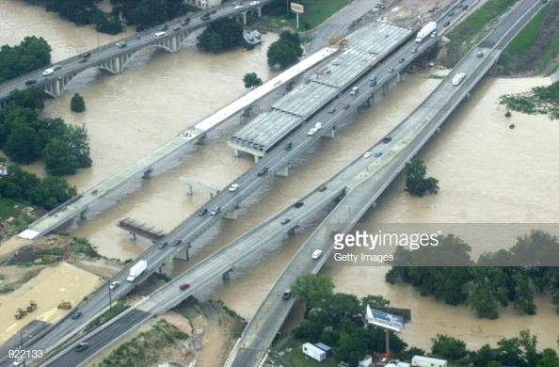
Guadalupe River in New Braunfels 10/31/2015
Notes:
Channelization of Streams

Slide 15
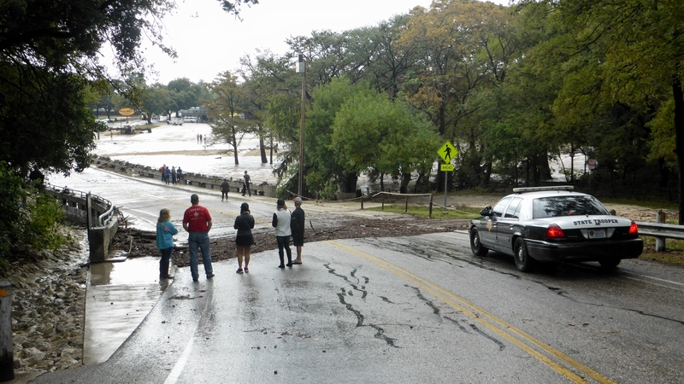
Guadalupe River – New Braunfels
10/31/2015

Slide 16
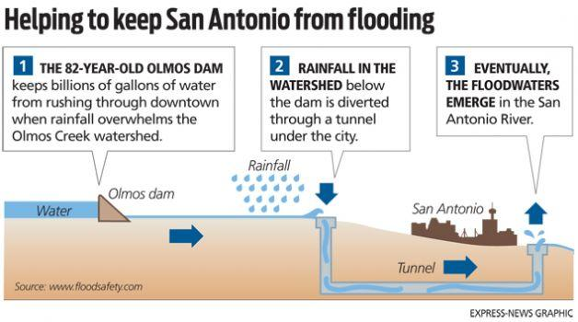
Notes:
San Antonio River – Olmos Dam

Slide 17
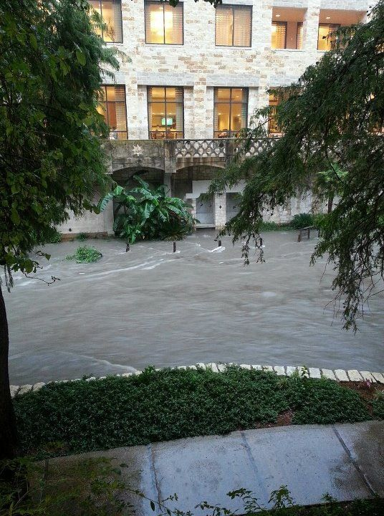
San Antonio River July 2012
Embassy Suites Riverwalk, 125 E. Houston St
Notes:
Channelization of San Antonio River

Slide 18
4. Fire Suppression Wildfire suppression is a range of firefighting tactics used to suppress wildfires. Wildfire suppression also addresses the issues of the wildland-urban interface, where populated areas border with wild land areas.
Practice resulted in increase in fuel accumulation due to woody species overgrowth
Prescribed burn: A controlled or prescribed burn is a wildfire set intentionally for purposes of forest management, farming, prairie restoration or greenhouse gas abatement, to decrease the likelihood of serious hotter fires
Fire is a natural part of both forest and grassland ecology and controlled fire can be a tool for foresters.

Slide 19
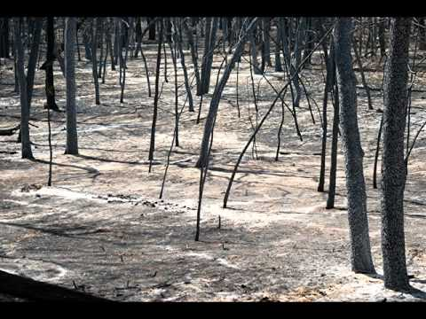
Bastrop State Park Fire
September 4, 2011
High winds + extreme fuel accumulation = high intensity crown fire
Notes:
Bastrop State Park Fire – 9/4/2011
High winds + extreme fuel accumulation = high intensity crown fire and damage to 96% of the park
In the end, fire impacted 96 percent of the 6,565-acre park.
Most notably, the fire significantly impacted the Lost Pines ecosystem, an area of isolated loblolly pines that is home to the endangered Houston toad. The toad is an endangered species whose last strong­hold was in Bastrop State Park. The toad suffered in the wake of the wildfire and drought. These amphibians require a habitat with plenty of tree canopy, so only time can restore their home.
Five years later, there is new growth. But estimates are it will take a generation for ecosystem recover.

Slide 20
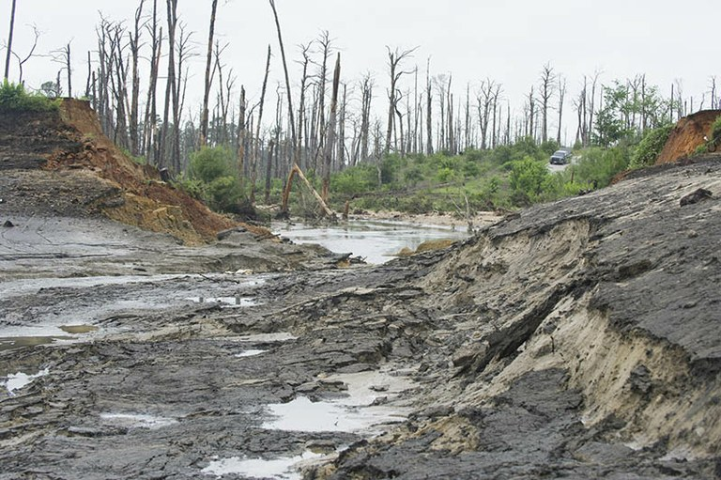
Bastrop State Park
May 25, 2015: Failure of dam on 10 acre lake
Notes:
Four years later, the dam on the 10-acre lake at Bastrop State Park failed after excessive rains. All of the water in the lake surged down Copperas Creek to the Colorado River. Lack of “normal” watershed environment contributed to dam washaway

Slide 21
5. Mining
The mine itself is but one component of the effect mining has on a watershed:
Transportation routes
Energy infrastructure
Processing plants
Tailings ponds
Waste rock piles
What mining occurs in Comal County?
FYI: https://tshaonline.org/handbook/online/articles/gpm01
Lists the minerals, where mined
Notes:
Transportation Routes
Energy Infrastructure
Processing plants
Tailings ponds: Tailings are residues from ore concentration; up to 90% of metal ore ends up as tailings; contain residues of toxic organic chemicals used in ore concentrators (eg toluene) Make metals formerly boun dup in sold rock accessible to water, increasing potential for heavy metal poisoning in aquatic communities (arsenic, cadmium, copper, lead and zinc)
Waste rock stored above ground – if contain sulfide minerals, react w/water & O2 to create sulphuric acid; leachate is known as Acid Mine Drainage; constant risk of water pollution
What mining is occurring in Comal County?

Slide 22
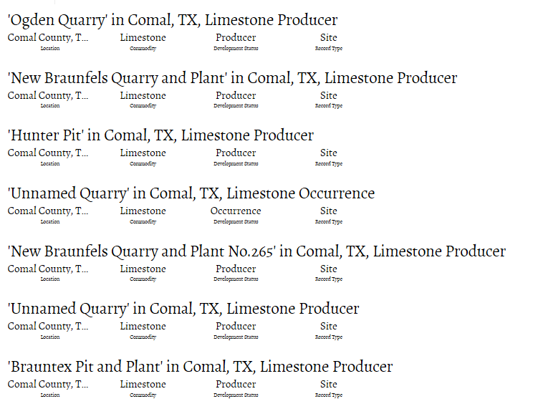

Slide 23
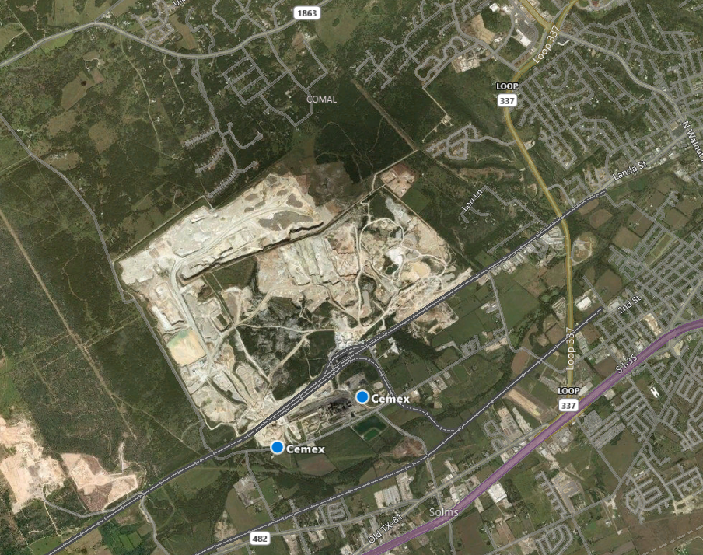
Cemex Plant in New Braunfels
Notes:
Transportation routes, energy infrastructure, waste rock piles

Slide 24
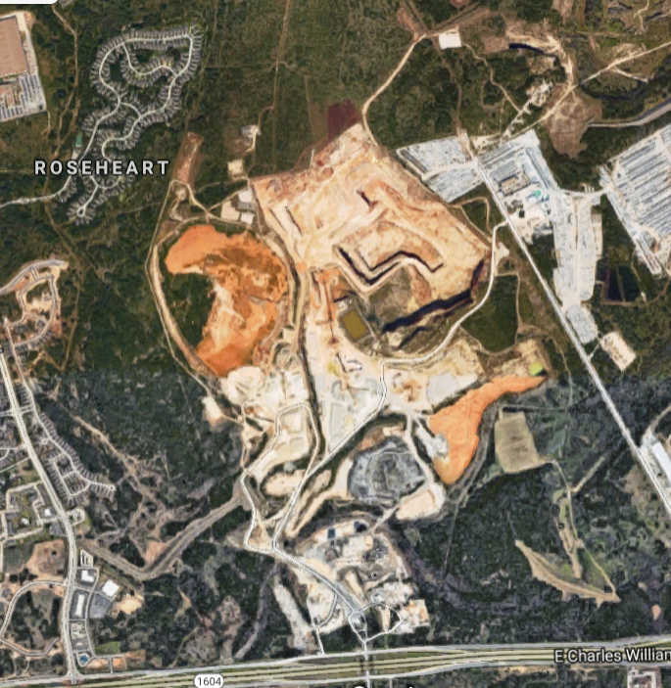
https://www.stop3009vulcanquarry.com/
https://www.stop3009vulcanquarry.com/impacts/water-resources/
Notes:
For those of you interested in the Vulcan Quarry situation. This is an anti-quarry site.

Slide 25
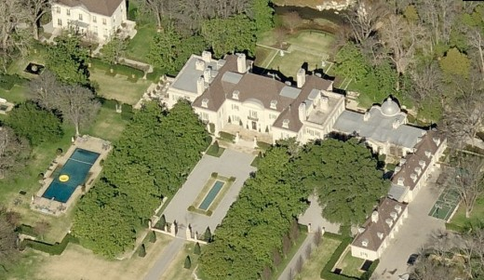
FYI: Perspectives on Fracking & the Environment
Fracking & Earthquakes: https://earthquake.usgs.gov/research/induced/myths.php
EPA https://www.epa.gov/uog
Pro
Con
https://corporate.exxonmobil.com/en/Energy-and-environment/Tools-and-processes/Hydraulic-fracturing
https://www.chevron.com/operations/shale
http://www.conocophillips.com/search/?q=fracking
https://www.halliburton.com/en-US/search0.html?query=hydraulic%20fracturing#
https://www.shell.com/service/search.html#q=fracking
https://www.sierraclub.org/policy/energy/fracking
https://www.greenpeace.org/usa/new-science-shows-fracking-contaminates-groundwater-yet-epa-still-muzzled-industry-pressure/
https://www.scientificamerican.com/article/fracking-can-contaminate-drinking-water/?redirect=1
https://earthjustice.org/features/texas-and-fracking
Resources: http://oilandgasthreatmap.com/threat-map/ (created by Earthworks, Clean Air Task Force & FracTracker Alliance)
http://www.nofrackingway.us/2014/02/21/exxon-ceo-supports-home-rule-opposes-fracking-in-his-back-yard/ In 2014, Rex Tillerson sued in support of Home Rule in order to keep the frack water supply tower (and the frack water trucks) away from his house.

Slide 26
Texas Mineral Resources
Rare earth mining
SIERRA BLANCA, TX— (Marketwired- August 15, 2018)
  Texas Mineral Resources Corp. (OTCQB: TMRC)
The Round Top deposit, located eighty-five miles southeast of El Paso, Texas, contains all of the rare earth minerals necessary for the production of rare earth magnets as defined by the recently signed FY19 National Defense Authorization Act (NDAA), Section 871 of the NDAA. Signed into law on August 13th, specifically requires that all rare earth magnets and tungsten be melted or produced in nations other than China, Russia, Iran and North Korea.
At full production, the Round Top project would potentially produce annual quantities of the following four rare earth minerals necessary in the production of rare earth magnets:
Neodymium: 230 metric tons per year
Praseodymium: 87 metric tons per year
Dysprosium: 208 metric tons per year
Terbium: 26 metric tons per year

Slide 27
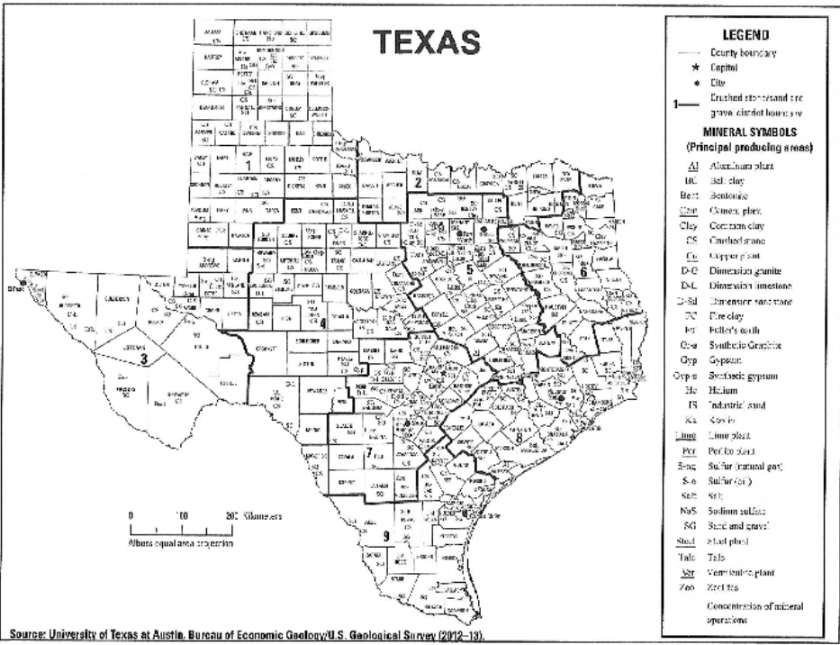

Slide 28
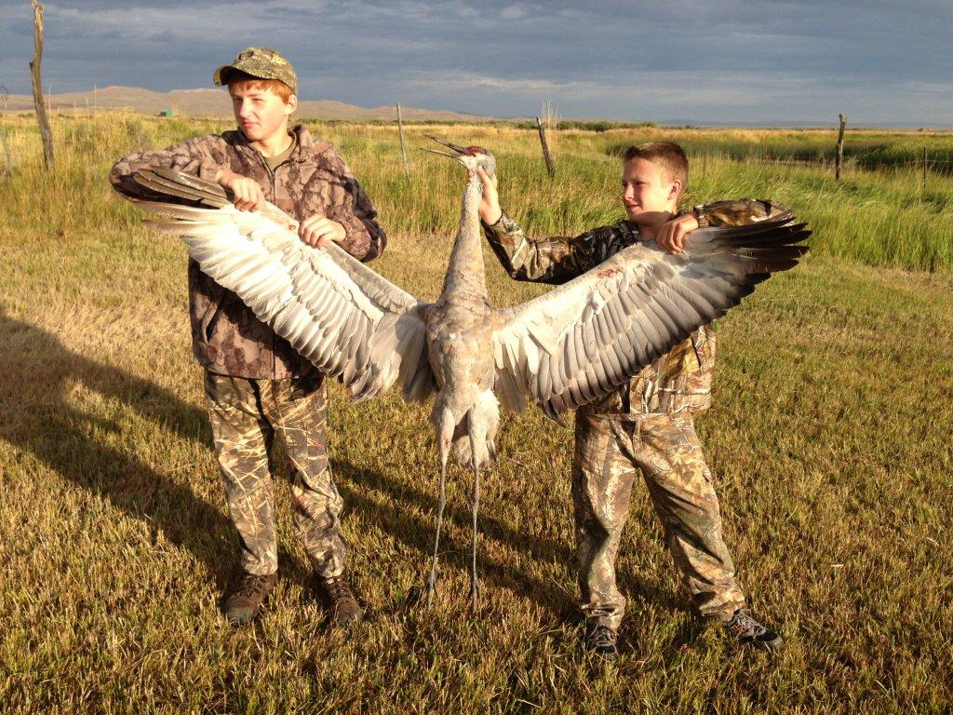
6. Harvesting of fish & wildlife
FISH – Freshwater
HUNT - Comal County
Basses – black, temperate
Catfish, bullheads
Crappie
Carp, minnows
Gar
Suckers (buffalo)
Other
Lake fishing will become endangered if zebra mussels truly thrive
Alligator
Dove
Duck
Goose
Javelina
Quail (poor habitat)
Rabbits/Hares
Rails, Gallinules and Moorhens
Sandhill Crane (Ribeye of the Sky)
Squirrel
Teal
Turkey
White-tailed Deer
Wilson’s Snipe
Woodcock

Slide 29
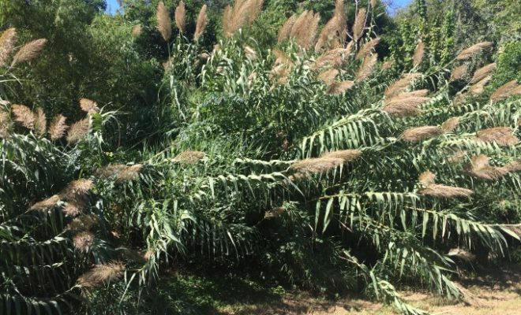
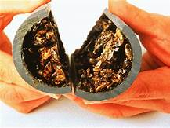
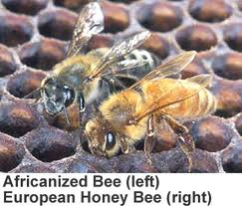
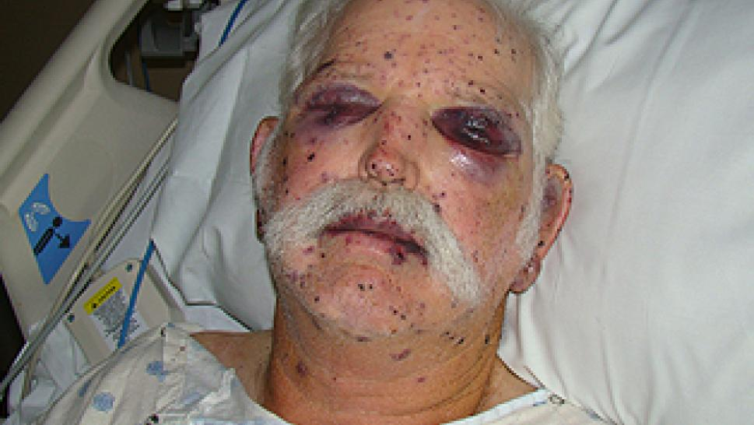
7. Introduction of Exotic Species
More than 800 invasive aquatic & terrestrial species in Texas
Effect of invasive species:
  Outcompete native species for food, resulting in significant changes in foodwebs & community composition
  Higher reproductive rates, crowd out native species, destroying habitats
  Create monocultures with loss of biodiversity affecting ecosystems
Estimated cost of $1 billion/year

Slide 30
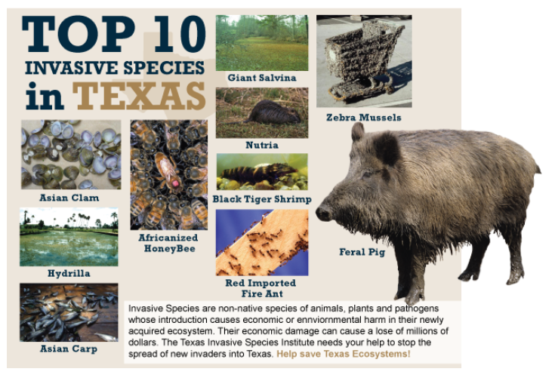
Top 10 Invasives
  Asian Clam
  Asian Carp
  Africanized Honey Bee
  Black Tiger Shrimp
  Giant Salvinia
  Red Imported Fire Ant
  Hydrilla
  Nutria
  Feral Hog
  Zebra Mussels
  https://www.texasinvasives.org/
  http://www.tsusinvasives.org/home/invasives-101/

Slide 31
8. Accelerated climate change
Major difference between natural & human caused climate change is the rate at which it occurs
  Carbon dioxide levels increased from 280 ppm to 360 ppm since 1860
  Global annual average temp increased 1.5°F since 1880
    More extreme variations (highs/lows) have negative impact on wildlife
https://www.nationalgeographic.com/environment/global-warming/global-warming-effects/ (2:34)
https://youtu.be/RkdbSxyXftc (4:54)
Dr. Roy Spencer, co-founder Greenpeace “Climate Change is not man-made”

Slide 32
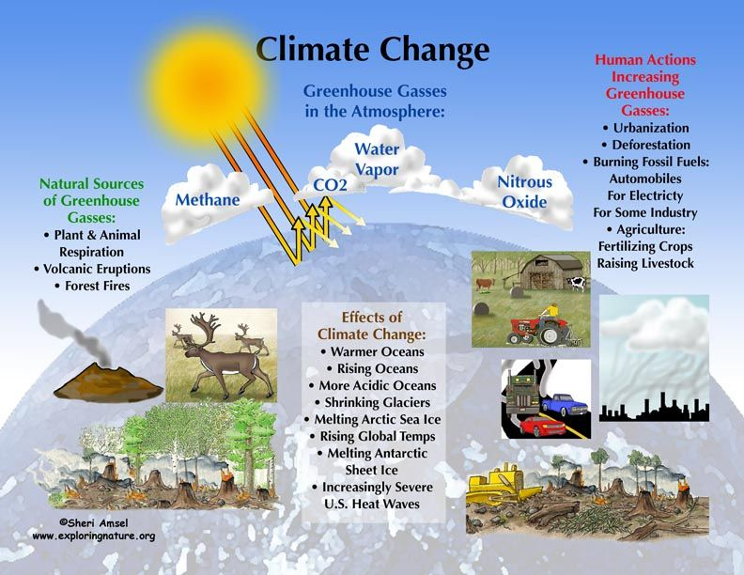

Slide 33
As the earth warms…
Shifts Species north
Lengthens Growing seasons
Changes migration patterns of birds & butterflies
Increases Pests & diseases because they don’t die off during winter
Creates more favorable conditions for woody shrubs
Changes soil moisture cycles
Causes Fish migration north

Slide 34
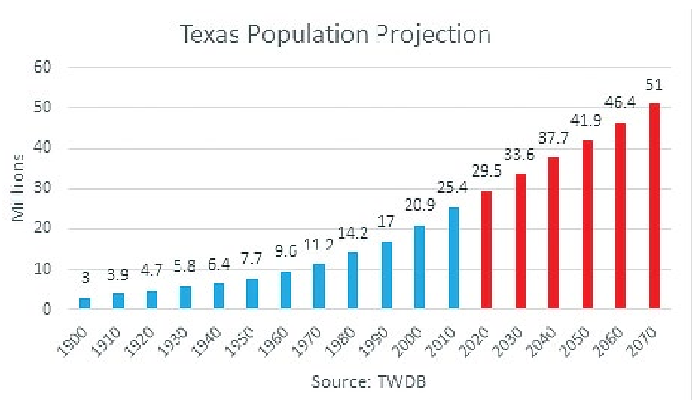
9. Human population & development

Slide 35
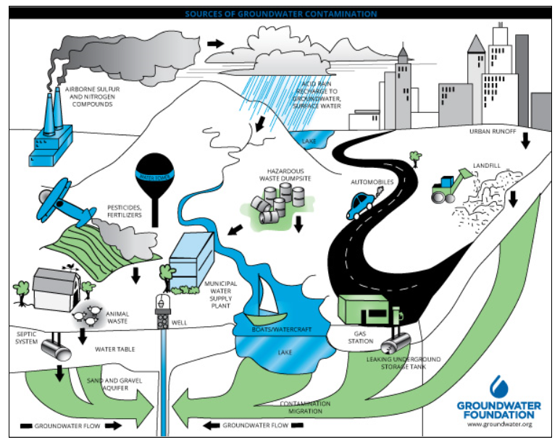
Sources of Groundwater Contamination

Slide 36
Pervious concrete https://www.concretenetwork.com/pervious
FYI: Impervious surface cover which accompanies human development causes many problems & damages the watershed. Is pervious concrete the answer?
Notes:
While this thirsty pavement is an excellent option for certain situations, it may not always be a viable choice.
Rough-textured, honeycombed surface, has moderate amounts of surface raveling & isn’t used for high traffic roadways.
"The main reason pervious concrete is not used for high-traffic pavements, such as highways, is surface raveling," says Youngs, who notes that tire sheer can loosen the aggregate at the surface. One potential solution being looked at is to grind down the pavement surface about half an inch.
Special attention must also be given to the overall design of the pavement system in order for pervious concrete to perform as intended. Proper engineering of the substrate beneath the pavement is essential, since it must be able to temporarily store the water while it percolates into the soil. An initial soils site survey and site-specific stormwater calculations should be performed by a stormwater management engineer.

Slide 37
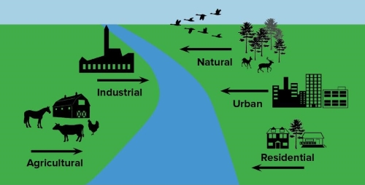
10. Non-point source of pollution
Definition: Pollution resulting from many diffuse sources, Nonpoint source pollution generally results from land runoff, precipitation, atmospheric deposition, drainage, seepage, or hydrological modification (rainfall and snowmelt) where tracing pollution back to a single source is difficult.

Slide 38
What about my water?
TxWaterCo | Make Every Drop Count

Slide 39
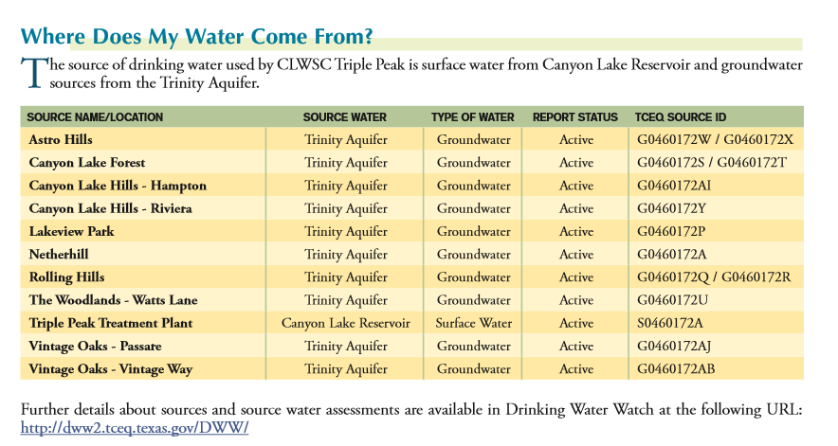

Slide 40
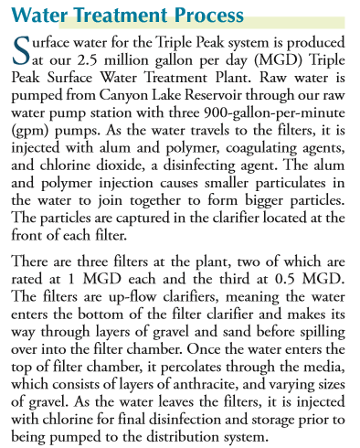
Notes:
Pump raw water, through up-flow clarifies (filters) & injected with alum, polymer, coagulating agents & chlorine dioxide. As it leaves filters, it is injected with chlorine.

Slide 41
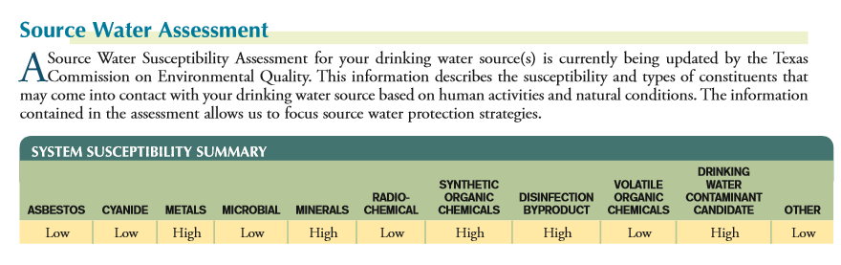

Slide 42
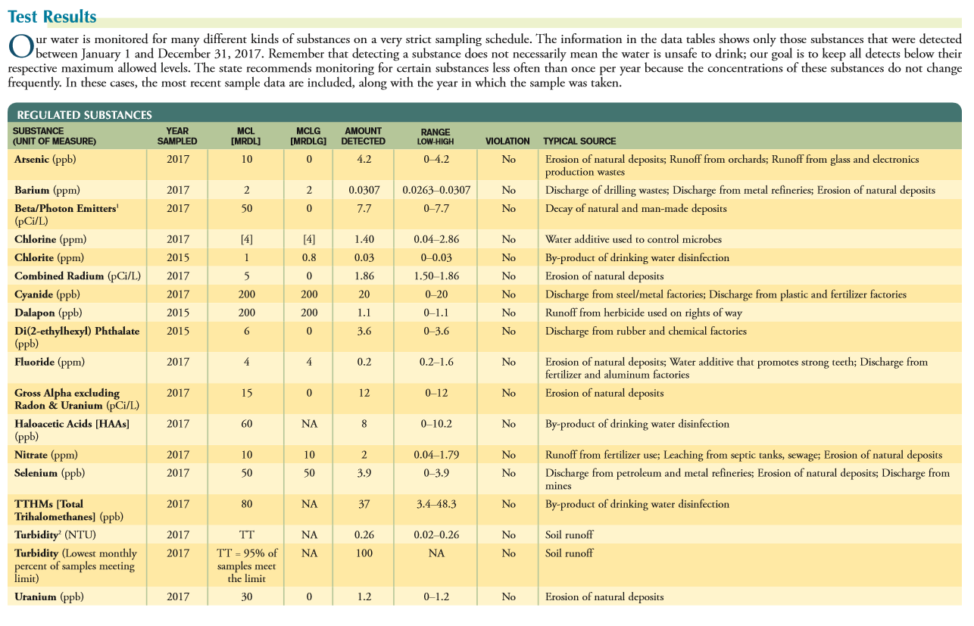

Slide 43
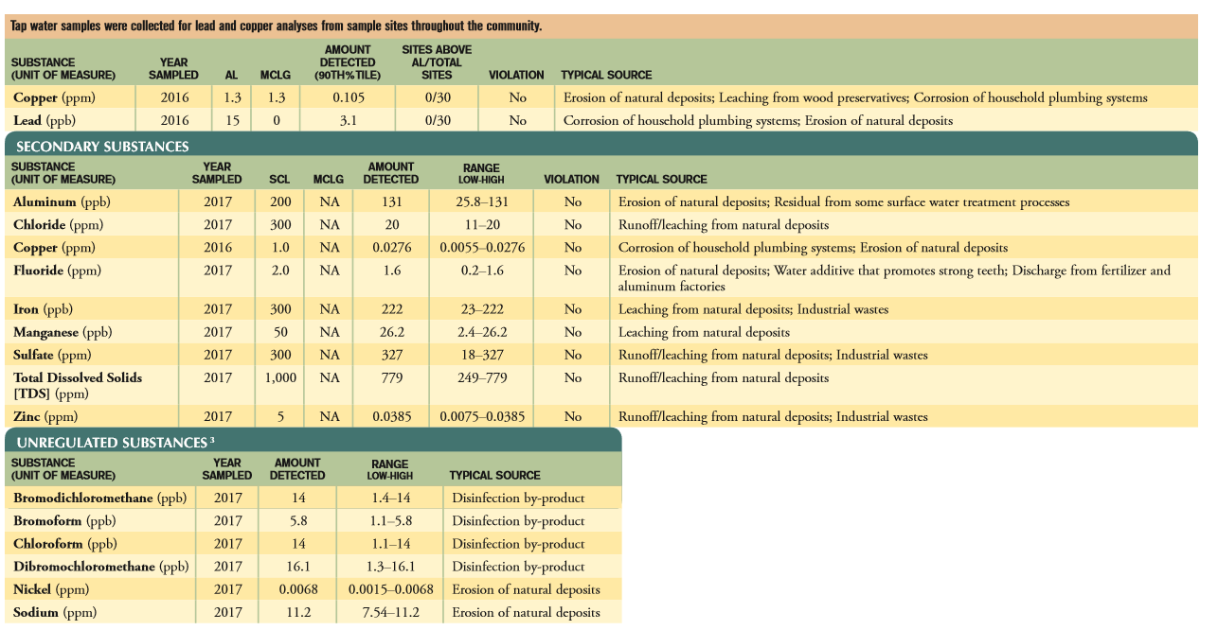

Slide 44
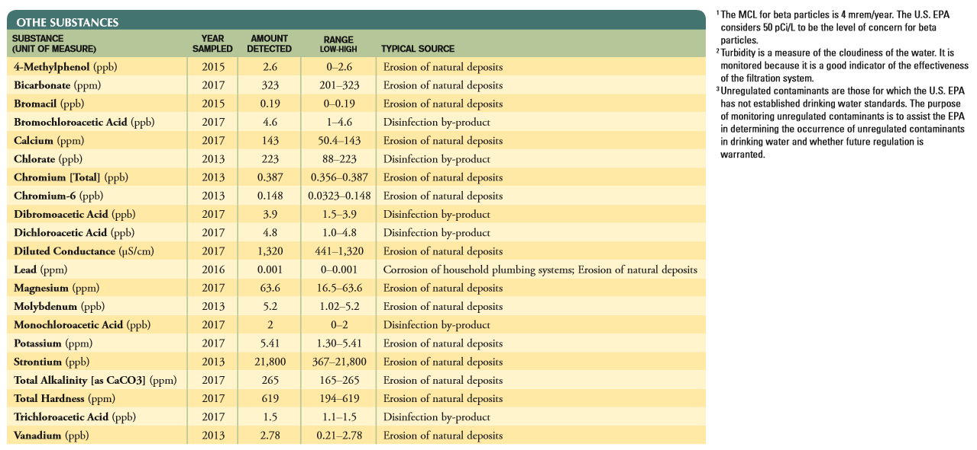
http://www.nbutexas.com

Slide 45
CONGRATULATIONS!
You have completed the Texas Waters Specialist Curriculum. If you input all your hours, the state will be able to identify you as a Texas Waters Specialist. In addition, I will send your names in to state. In October you receive a certificate and pin.
Lindheimer Chapter gives you a Certificate of Completion for Texas Waters Specialist Curriculum. Those who need a make-up class will receive a Certificate of Attendance for the number of hours obtained. When you have completed the make-up class you will receive the Certificate of Completion.
Thank you for attending the course!

Slide 47
It’s not all gloom & doom in Texas nature:
https://youtu.be/tPK7kNH5Ae4 (4:03) Paddlefish Return to Caddo Lake
https://youtu.be/ZSPkcpGmflE (8:05) Selah

