Slide 2
Welcome!, but before we begin…
Who are we?
Name, Chapter, Position
Any volunteers to scribe?

Slide 3
1. Call for Proposals
FAQ’s
Sample e-mail script
Presentation review of past meetings

Slide 4
FAQ’s for Speakers
How do they submit a proposal?
Proposals can be submitted online through the TMN Proposal website: http://www.regonline.com/TXMN2016CallforProposals
What information is needed on a proposal?
The basics are Presentation title, an abstract about what will be presented, the theme or topic for the presentation, and the duration of the presentation.
Is there any available compensation for travel?
Typically no. Most of our speakers will come to share their passion with a like-minded passionate group. If compensation is needed, either via travel funds or the conference contract rooming rates, that can be discussed. Have them email/call Mary Pearl.

Slide 5
FAQ’s for Speakers (cont)
Is there a registration discount or any perks?
Of course there are perks – they are a presenter for the TMN group! But no, we typically do not have a discount for registration. Again, if this is a limiting factor, have them email/call Mary Pearl.
When/how will their proposal be accepted?
The deadline for submissions is June 3rd, and we will try to have the final proposal selections done by end of July or early August.
How many presenters/sessions do we normally have at the Annual Meeting?
Last year in Horseshoe Bay we had 98 concurrent sessions offered by 60+ presenters (many of them spoke multiple times). It will be relatively similar this year at La Torretta. Additionally, our total attendance last year was a little over 450.

Slide 6
FAQ’s for Speakers (cont)
Who has spoken at past Annual Meetings?
This can be found on our Annual Meeting historical page by looking at previous years agendas. Check it out here: http://www.txmn.org/past-annual-meetings
Also – if there is a recommended topic/theme that you would like to be a part of the Annual Meeting, but don’t know of a specific presenter/expert in that field – reach out to your fellow TMN State Representatives and chapter members for recommendations/help.

Slide 7
Sample E-mail Script
I am contacting you because of the exceptional presentation you made to the Lost Pines Master Naturalists. I am our chapter’s State Representative and wanted to let you know about the Texas Master Naturalist Annual Meeting held each fall in October. Master Naturalists from across the state attend to network and participate in advanced training classes on topics ranging from chapter administration to water analysis to wildlife management.
I encourage you to review the information for this year’s meeting, being held October 23 – 25 near Conroe, at the Texas Master Naturalist website, TXMN.org. Proposals for training sessions, which can be anywhere from 30 minutes to full days, are currently being solicited. We are looking for presenters who have demonstrated both expertise and presentation skills, and would be pleased to have you submit a proposal.
While we regrettably cannot offer an honorarium, the meeting and training conference provides a unique opportunity for networking with your peers in related fields plus training and soliciting TMN volunteers to assist with your current projects, as well as interacting with Texas Parks and Wildlife Department biologists, Texas A&M AgriLife Extension personnel, other experts, and partners. The meeting has grown along with the Texas Master Naturalist program, attracting 475 attendees last year.
I have attached a document providing details about the meeting and the proposal process. Proposals can be made on-line at http://www.regonline.com/TXMN2016CallforProposals . The deadline for submissions is Friday June 3rd, 2016. If you have any questions about the Annual Meeting, please contact Mary Pearl Meuth by email (mpmeuth@tamu.edu) or by phone (979) 845-7294. Hope to see you there!
Marsha Elrod
Texas Master Naturalist
Lost Pines Chapter State Representative

Slide 8
Presentation Review of Past Meetings

Slide 9
2. Areas of Need Pre-conference
Call for proposals
Meeting Sponsorship
Marketing Campaign
Silent Auction: Heartwood Chapter chairs – need help identifying donations
Registration reminders and marketing
Reminder/Announce Chapter Advisor Award nominations
Reminder/Announce video contest

Slide 10
2. Areas of Need At conference
Registration desk – team of 3- 4 to manage
AgriLife Bookstore – more info needed
Signs set up – help post signage for meeting spaces
AV equipment: need set-up and pack up help with screens, projectors, and computers
Photo contest – need a chair

Slide 11
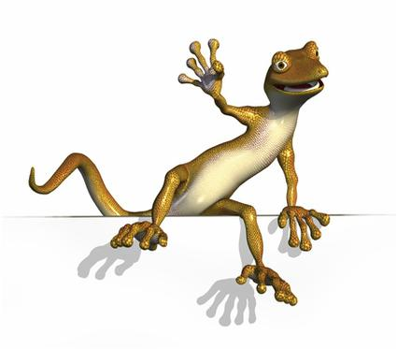
Wrap Up
State meeting session for State Representatives to review “pluses and deltas;” how long, and what else do we need to cover.
If someone needs to come Thursday or stay over Sunday, the conference room rate is available two days prior and two days post conference
General Q & A
THANKS!

