Slide 1
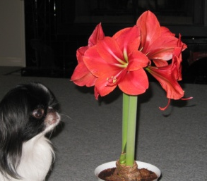
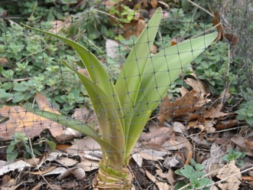
Plant Research
My wonderings:
What I think I know:
How can I find out?

Slide 2
What happened?

Slide 3
Questions

Slide 4
Plant Research
My wonderings:
What I think I know:
FACTS
How can I find out?
Yes, I learned:
CONFIRMING INFORMATION

