Slide 1
Climatology
Why do we study Climate?
Climate is a significant factor in the development of all major aspects of the life.

Slide 2
It’s Climate that attracts people to a location
It’s the Weather that makes them leave

Slide 5
Certain ecosystems (a system of interconnecting and interacting parts) attract people.
What was available for civilizations to last/develop?
Levels of economic growth

Slide 6
Primary economic activities are those that use natural resources directly and these economic activities are located at the site. The economy is dominated by subsistence activity where output is consumed by producers rather than traded. Any trade is carried out by barter where goods are exchanged directly for other goods. Agriculture is the most important industry and production is labor intensive using only limited quantities of capital.

Slide 7
Secondary economic activities use raw materials to produce or manufacture something new and of monetary value. Examples of secondary economic activities include manufacturing steel, processing wheat into flour, milling lumber into plywood, iron smelting, chemical industries, power production, and construction. Activities are located either at the site of the resource or close to the market for the manufactured/processed good. In the case of lumbering, the finished product is cheaper to ship than shipping the raw materials to the lumber mills so the lumber mills are located close to forests to minimize costs (and maximize profit). In the case of flour and bread, it is cheaper (and easier) to ship wheat than the finished product, bread. Consequently, bakeries are located close to consumers in cities, again, to minimize costs. These activities fueled the Industrial Revolution.

Slide 8
Tertiary economic activities are those activities which provide services, personal and professional services such as doctors, teachers, dry cleaners, and secretaries as well as retail and wholesale services such as store clerks, truck drivers, and fast-food providers. These activities are located where services are required, that is where people are.

Slide 9
Quaternary. In modern economies some individuals process, administer, and disseminate information. Such activities are termed quaternary which is used to describe "white collar" professionals working in education, government, management, information processing, and research. These activities are not tied to resources, the environment, or access to a market. With improvements in telecommunications, these economic activities can be located anywhere. Factors which do tend to affect the location of "high-tech" economic activities include access to universities and research centers and to a pool of highly trained and skilled workers, availability of venture capital, proximity to places with high quality of life attributes (scenery, recreation, climate, quality education system) and access to excellent transportation and communication networks.

Slide 10
So what are WE going to talk about tonight?
Time Scales over which Climate Changes
Processes that “Make” Climate
Human Effect on Climate

Slide 11
Two important questions when studying climate are:
What are the systems involved?
Over what scales (time frames) do they operate?

Slide 12
Methods used by scientists to determine past temperatures:
Testing ice cores
Deuterium
Marine Fossil shells
oxygen isotope O₁₈

Slide 14
Interglacials
An interglacial period is a geological interval of warmer global average temperature lasting thousands of years that separates consecutive glacial periods within an ice age.

Slide 15
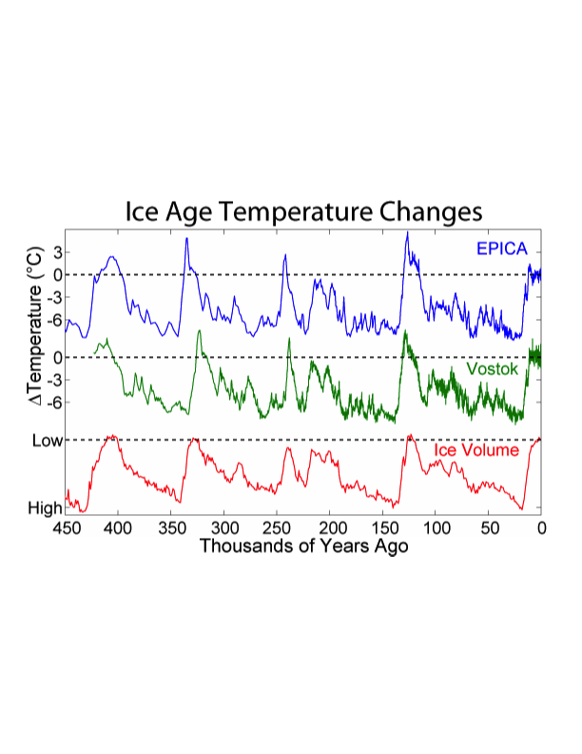

Slide 16
Milankovitch Cycles
describes the collective effects of changes in the Earth’s ellipticity and obliquity over 10’s of thousands of years
Ellipticity changes from near circular to oblong over a 95,000 year cycle
Obliquity changes from 22° to 24.5° over a 42,000 years cycle

Slide 19
Earth’s Obliquity

Slide 22
Atmosphere
Troposphere
Stratosphere
Mesosphere
Thermosphere
Exosphere

Slide 23
Atmospheric Gasses –
Constant | Variable
78 % Nitrogen | Water vapor (H20)
21% oxygen | Ozone (O3)
helium (He) | Carbon dioxide (CO2)
argon (Ar) | Methane (CH4)
krypton (Kr)
xenon (Xe)
nitrous oxide (N2O)
hydrogen (H2)
neon (Ne)

Slide 24
Water Vapor
Most abundant
Absorbs solar heat
Absorbs heat from the surface of the Earth

Slide 25
Ozone
Absorbs the most energetic ultraviolet light known as UV-C and UV-B

Slide 26
Methane
The most abundant reactive trace (least abundant) gas in the atmosphere and arises from both natural and anthropogenic (human) sources.

Slide 27
Carbon dioxide
Carbon Dioxide (CO2)– historically distributed uniformly until the burning of fossil fuels and now is becoming more concentrated
* it’s affect on weather is its ability to absorb infrared radiation

Slide 28
Carbon Cycle
Shallow Earth
Carbon in oceans in marine life and organic sediments on the ocean floor
Deep Earth
Plate tectonics

Slide 30
Appalachian Mountains

Slide 31
Controls on climate
Latitude
Land/Water distribution
Geographic Position
Pressure
Mountains

Slide 35
Sunspots
Ocean Current Fluctuations
Eruptions of volcanoes

Slide 36
Sunspots
Regions of very strong magnetic fields that partially inhibit sun’s convection at that point. When they occur more energy is stronger in surrounding regions and emits even more energy

Slide 40
Ocean Circulation Fluctuations
El Niño
La Niña
Gulf Stream

