Slide 1
A guide to guiding/Intro to Interpretive Walks
Adrienne Paquette
Texas wildlife association L.a.n.d.s. outreach educator
Texas master naturalist Heartwood chapter

Slide 2
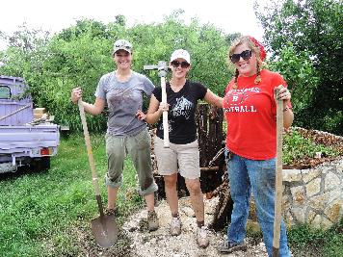
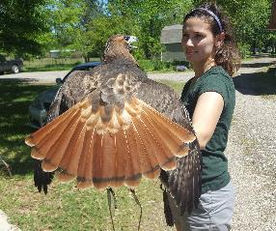
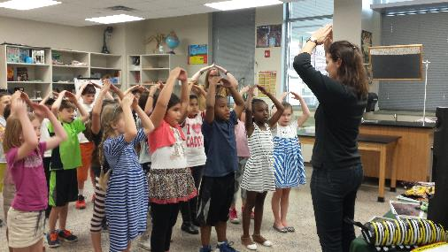
2012 Bachelor’s of Science in Animal Science from Texas A&M University
2014 Master’s of Science in Environmental Management and Sustainability from St. Edward’s University and Université Catholique de l’Ouest
2014 Education intern at Fossil Rim Wildlife Center in Glen Rose, Texas
2015-present L.A.N.D.S. Educator for Texas Wildlife Association
2016-present Heartwood Master Naturalist
Secretary
Public outreach coordinator

Slide 3
Guiding basics
Why interpretive tours?
T.O.R.E. method
2. Introduction techniques
Learning names
Attention-grabbers
3. Storytelling 101
Games and activity ideas
4. Handling complications
5. How to set up a tour + tour theme ideas
6. Final tips
7. Resources
8. Virtual Hike

Slide 4
GUIDING BASICS
Guiding is:
“a process aimed at provoking audiences to do their own thinking and thereby develop their own understanding of your topic”
– Sam H. Ham, director of the Center for International Training and Outreach and author of Interpretation: Making a Difference on Purpose

Slide 5
Guiding Basics
Why interpretive tours?
Share passion and knowledge
Spark curiosity in others
Increase understanding and appreciation of nature
The goal of this training is to share our passion with each other and others in a way that sparks curiosity and appreciation for our subject matter.

Slide 6
Maslow’s Hierarchy of Needs Related to Guiding:
Physiological
Water
Shelter
Food
Space
Air
Sleep
Safety
Love and Belonging
Esteem
Self-actualization
Make clear the amount of time you will be spending away from these things
Make it known how to find these resources (water, shelter, restrooms)
Take note of how many are on your tour
Take regular breaks to survey people and your surroundings

Slide 7
Guiding Basics: The T.O.R.E. Method
Topic and Theme
Organization
Relevant
Enjoyable

Slide 8
Topic and Theme
Topic: plants
Theme: how the diversity of plant species increases the numbers of bird species

Slide 9
Organization
No more than four main ideas
Types of plants
Plants’ needs
Types of birds
Birds’ needs

Slide 10
Relevant
Make it personal and meaningful
Don’t use too many technical terms (know your audience)
Make them care
Relate to emotions, functionality, and mystery

Slide 11
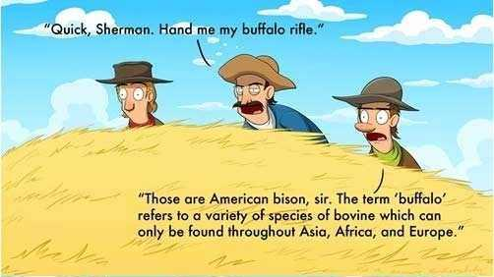
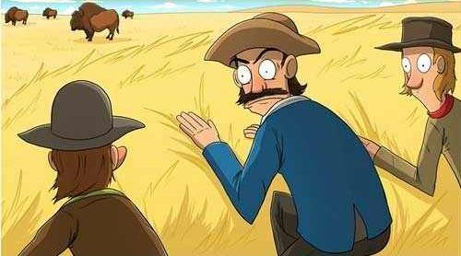
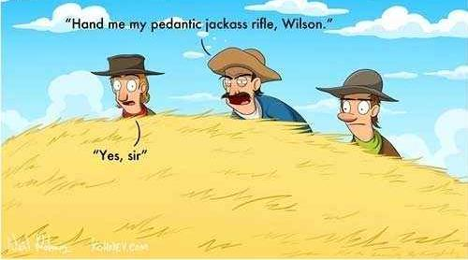

Slide 12
INTRODUCTION TECHNIQUES
Learning names
Attention-getting

Slide 13
learning names
Pay attention and consciously use their name
Association (alliteration, rhyming, relate to someone you know with the same name)
Use lists available to you and keep notes
Don’t make excuses! If you don’t remember, ask them directly

Slide 14
Attention-getting techniques
Always start with the attention of the group and only speak with full attention
Engage disruptive guests
Use hand gestures or claps
Leverage your physical environment
Treat attention with the respect it deserves

Slide 15
STORYTELLING 101
+ games and activity ideas

Slide 16
Storytelling 101
What is your message
Moral, lesson, and/or humor
Who is your audience
Show, don’t tell
Practice!

Slide 17
Games and activity ideas
Use your theme (flashlight tag at night hikes, bird BINGO on bird hikes)
Pay attention to the weather and time of day (rain, heat, mud)
Plogging
Dog-friendly
CSI
Photography
Artist

Slide 18
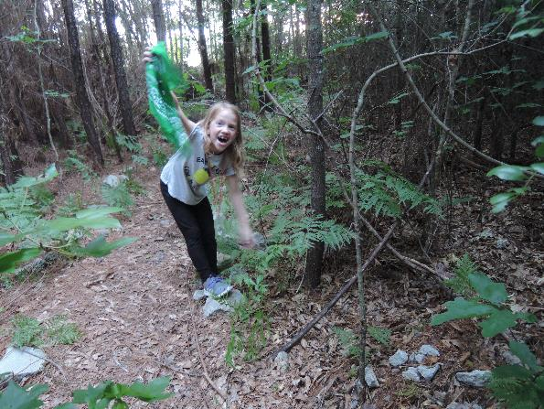
Games and activity ideas
“Camouflage Trail”

Slide 19
Games and activity ideas
“Micro Hike”

Slide 20
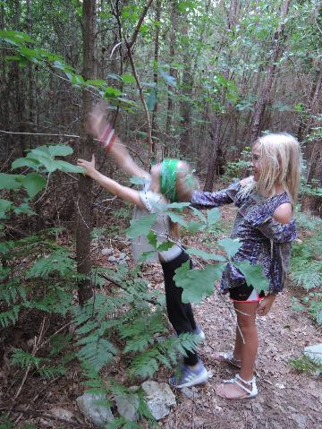
Games and activity ideas
“Meet a Tree”

Slide 21
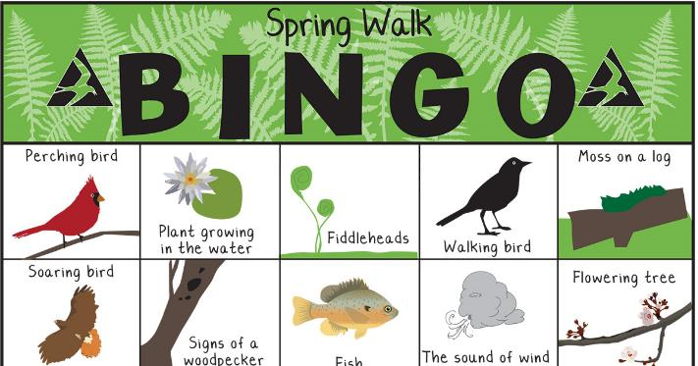
Games and activity ideas
“Scavenger Hunt BINGO”
www.massaudubon.org/get-outdoors/young-explorers/explore-a-sanctuary/nature-bingo

Slide 22
Other types of hikes
Youth hikes: engage the senses, simple vocabulary, use technology (iNaturalist, birding apps, geocache, etc.), keep it short
Family hikes: stroller-friendly?, noisy?, keep adults and kids interested!
Experienced hikes: engage in discussion, can use more technical terms, utilize guidebooks

Slide 23
HANDLING COMPLICATIONS

Slide 24
Handling complications
L.A.U.G.H. Method
Listen without interruption
Acknowledge
Understand – show you get it; ask questions
Give solutions – avoid excuses and blame
Hit home – be 100% sure the outcome is satisfactory, follow up

Slide 25
Handling complications: Common issues
“Accidental rule breakers”
Whiners
Wanderers
Non-stop talkers
Teenagers
Adults!

Slide 26
HOW TO SET UP A TOUR/HIKE

Slide 27
How to set up a tour/hike
Contact your favorite park or nature center
Get in touch with scouting groups – Sam Houston Area Council (Boy Scouts), San Jacinto Area Council (Girl Scouts)
Join already-established tours/hikes
Houston Arboretum
Mercer Botanical Gardens
WG Jones State Forest
HCP4.net

Slide 28
FINAL TIPS & RESOURCES

Slide 29
Final tips
When in doubt, be more informal than formal
Don’t be afraid to not know everything
Share your passion!!!

Slide 30
Resources
BeABetterGuide.com
Certified Interpretive Guide trainings – National Association for Interpretation interpnet.com
North American Association for Environmental Education – naaee.org
YouTube

Slide 31
Virtual hike
1. Your audience: a mix of families and adults with minimal experience in the outdoors
2. Based on your topic, come up with between 30 seconds and a minute of information
3. Be ready to present when a picture of your topic shows up on the screen

Slide 32
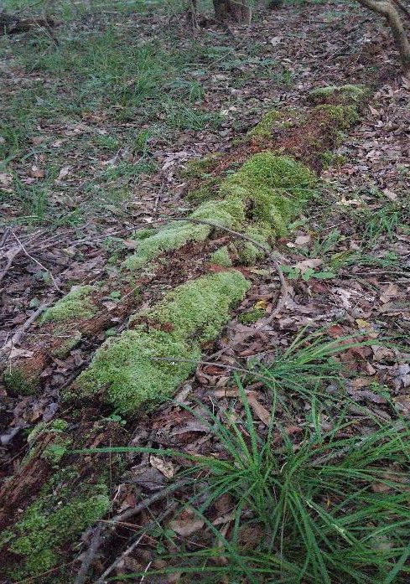
Do you know what kind of tree this is? A dead one! This tree would have once towered over us, but now it give its life to be home to some special decomposers. There are three main decomposers here: the F.B.I.! No, there’s no SWAT team coming to decompose this tree. Rather, there’s Fungi, Bacteria, and Invertebrates playing a role in turning this tree into nutrients in the soil for other plants to use!

Slide 33
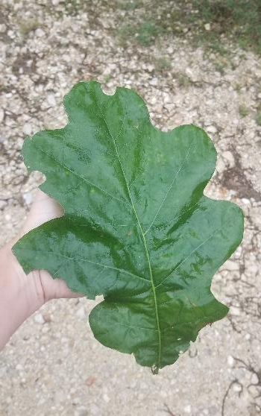
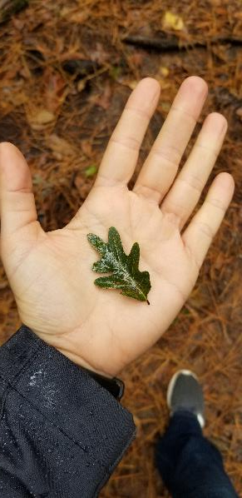
Check out these special leaves! They come from white oak trees, which have rounded lobes, unlike the pointy leaves of red oaks. It’s amazing how this tiny leaf in the spring will grow to be so large in the summer. Why do you think these trees need such big leaves?

Slide 34
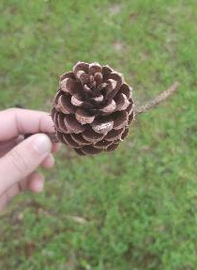
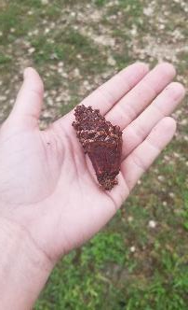
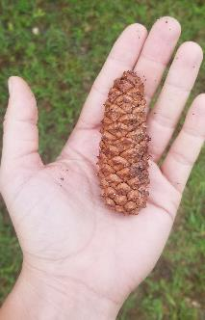
What kind of tree makes pinecones? Pine trees! They can be so beautiful when they are open. When a pine cone gets wet, they close up. Why do you think this one was picked apart? Squirrels love to eat pine nuts! If you are lucky enough to find a pine cone that hasn’t been picked apart by a squirrel, pick off these spines one at a time and see if you can find the pine nut. There is usually a small wing-like structure that makes the pine nut twirl like a helicopter in the wind!

Slide 35
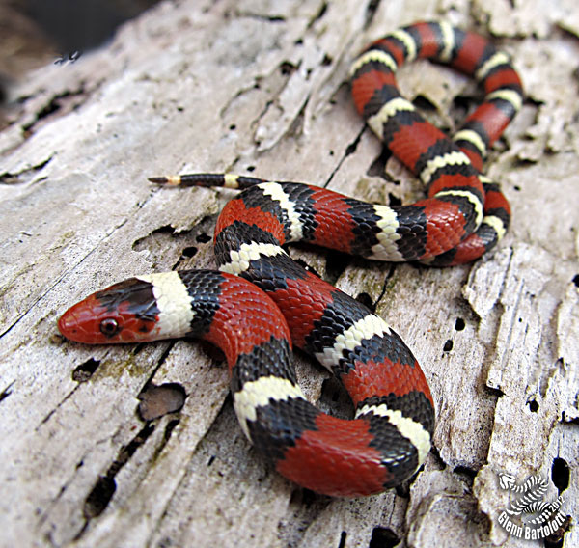
Hey there, snake friend! What kind of animal is a snake? It’s a reptile, which means it’s cold-blooded. Reptiles like snakes have to keep warm by sunbathing on sidewalks and rocks, so keep an eye out for these guys. Some snakes are venomous, but this one isn’t. Do you know how to tell the difference? This milk snake has colors that mimic the coral snake, which is a venomous snake. All snakes are beneficial by eating pests like cockroaches and mice, and some even eat other snakes! It’s best we leave our snake friends alone and let them do their important jobs!

Slide 36
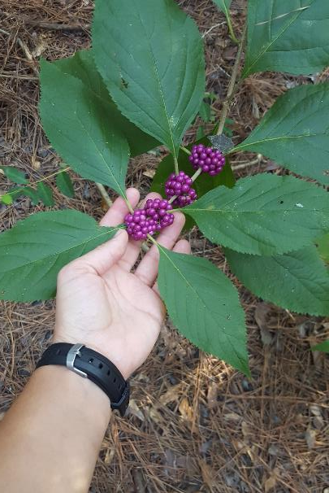
This plant is pretty! Do you think we should eat it? Normally, it’s best to not eat anything that we cannot 100% identify. I know that this plant is called American Beautyberry, and most people can tolerate eating small amounts of berries from this plant, although raw berries taste somewhat bitter. You can even make the berries into a delicious jelly that tastes a little like roses! The leaves of this plant can also act as a deterrent to mosquitos if you crush it up and rub it on your skin. But remember: while this plant is safe, avoid touching or eating anything you find in the wild! I also want to leave this plant alone so the birds, raccoons, and other animals can eat it, too. I bet we can find some raccoon scat with these berries in it!

Slide 37
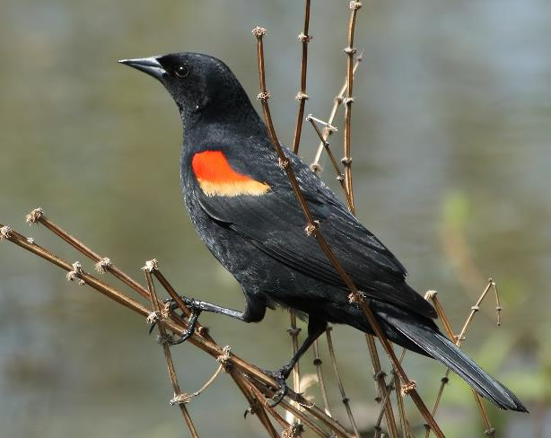
Can you hear that bird? We must be close to a pond! This bird is called a Red-winged Blackbird, and they love to hang around freshwater sources like ponds and lakes. If we find the bird, you might see some that have a red patch on their shoulders. Those are the male birds, but the females are plain brown. Why would a female need to be more camouflaged than the male? Hint: what does the female do that the male doesn’t?

Slide 38
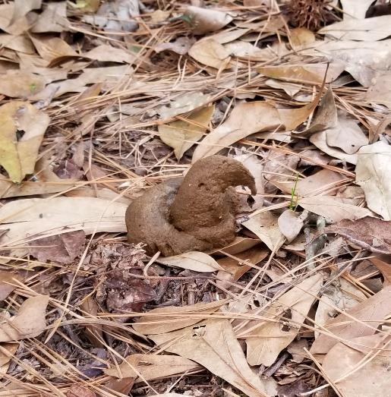
Uh oh! Watch your step! Someone was not a good steward of our trail. It’s important that we pick up after our pets. Did you know that one of the biggest sources of pollution in our waterways in Houston is bacteria from dog poop?? Let’s keep this poop from going into the source of our drinking water and pick it up with a bag and throw it away in the next trash bin we see.

Slide 39
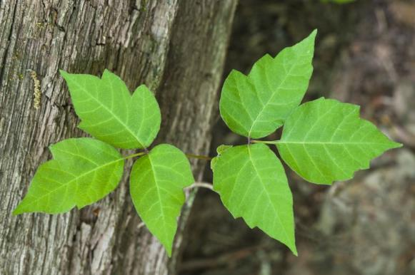
One of the most important rules while we’re on the trail is to never put your hands or your feet anywhere that your eyes have not been. This means watch where you put your hands and watch where you step! This may look like a harmless leaf, but if I accidentally leaned against this tree without looking first, I could have been very itchy. This is poison ivy! I remember that it’s poison ivy because it has leaves of three, so I leave it be! Another rhyme I use is, “leaves shaped like mittens: run like the dickens!” When poison ivy doesn’t have leaves, watch for “hairy, scary” vines.

Slide 40
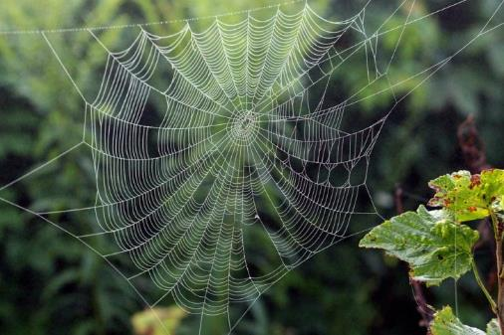
Wow! Look at this web! Do you think Spiderman lives here? Spiders that make webs like this are called orbweavers. Some spiders make funnel-shaped webs, so we call them funnel-web spiders, and some spiders don’t use a web to trap their food at all! We see jumping spiders all the time that catch their prey in the blink of an eye! While many people are afraid of spiders, they play an important role in our ecosystem. Do you know what a spider eats? I’ll give you a hint: it’s not pizza!

Slide 41
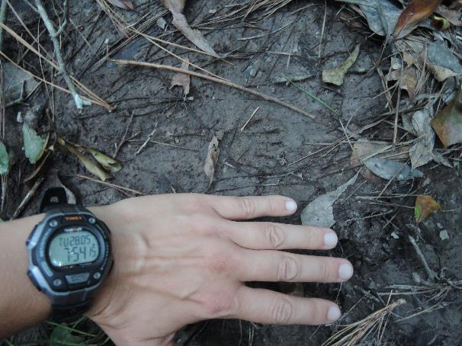
Watch your step in the mud! After it rains is a perfect time to look for tracks left behind by critters like this one. What kind of animal has hands like this with thumbs for opening your trash can? A raccoon! Raccoons will often soften their food by dunking it in water, so their tracks are very common to find near creeks and rivers. Let’s step carefully and see if we can find any other tracks!

Slide 42
Thank you!
Contact information:
apaquette@texas-wildlife.org
heartwoodsec@gmail.com

